Slide 1
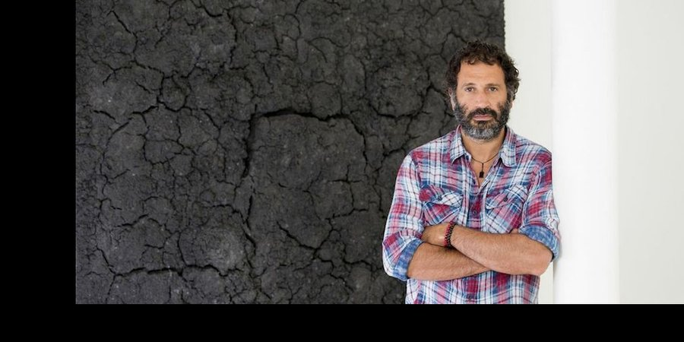
Bosco Sodi:
An Homage to Spanish Artists
Notes:
Image source: https://www.artspace.com/magazine/interviews_features/meet_the_artist/bosco_sodi_interview-52246

Slide 2
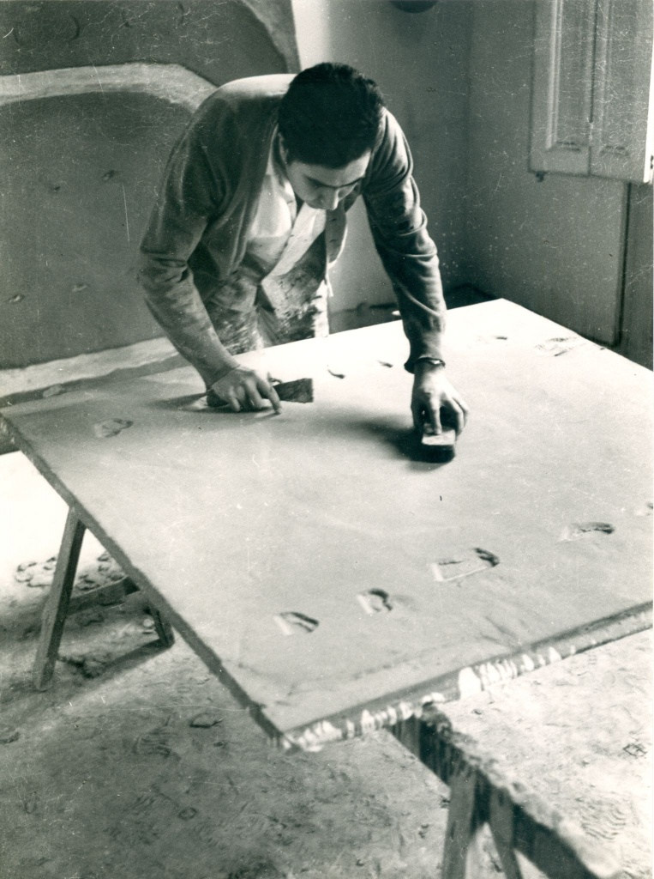
“When I was about 18 years old, I saw an image of a painting by Antoni Tàpies for the first time in a magazine. I don’t remember which magazine anymore, however, I remember seeing the black-and-white image. Even without color, the painting looked strong and powerful. I immediately fell in love.”
--Bosco Sodi
Antoni Tàpies in his studio, 1940s
Notes:
Image source: https://www.alminerech.com/artists/5558-antoni-tapies
Quote source: https://www.cobosocial.com/dossiers/five-encounters-with-antoni-tapies-by-bosco-sodi/

Slide 3
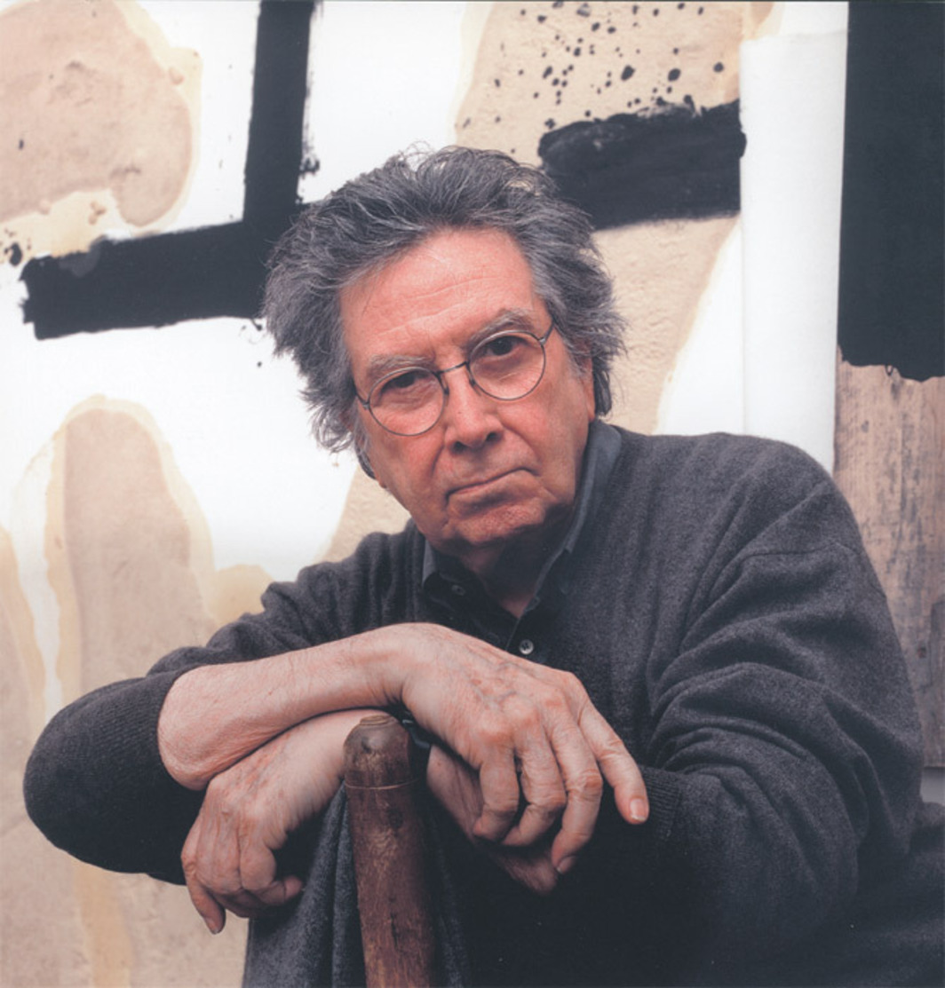
Antoni Tàpies
Spanish modern artist (b. 1923, Barcelona; d. 2012, Barcelona)
Known for arresting, striking visual language
Used a variety of materials
Antoni Tàpies in his studio in Campins, Catalonia, Spain, 2002
Notes:
Tàpies is an important Spanish (Catalan) artist whose work deeply influenced the young Bosco Sodi, years before Sodi knew he would devote his life to art.
Image source: https://www.artforum.com/print/201206/antoni-tapies-31079
Antoni Tàpies in his studio in Campins, Catalonia, Spain, November 4, 2002. Photo: Martí Gasull.

Slide 4
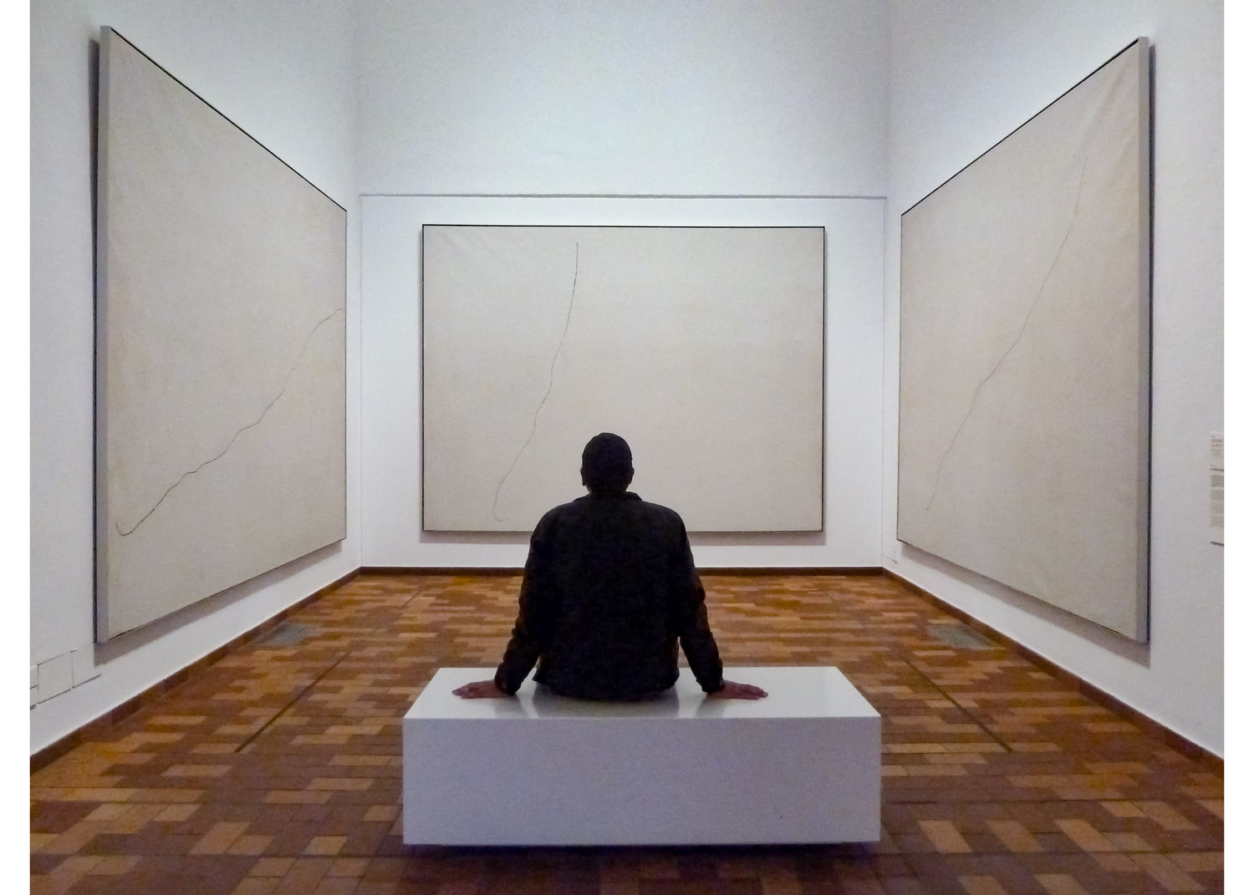
Notes:
Artist in the Miró Chapel, Barcelona, Spain.
Source: https://www.kasmingallery.com/exhibition/bosco-sodi--vers-lespagne/showroom
“The first phase of the Vers l’Espagne project consisted of Bosco Sodi’s trip to Barcelona to see the Miró chapel again for himself. He had the authorization of those responsible at the foundation to remain alone in the room for two hours; some photographs show him in the room, going up to the paintings, becoming imbued with and pervaded by the spirit of their author, meditating on Mironian freedom.”
– Juan Manuel Bonet, “A Format, A Color”, Bosco Sodi, Published by Rizzoli, 2020, pg. 18.
From https://www.artsy.net/show/kasmin-bosco-sodi-vers-lespagne/info:
In this series, Sodi calls particularly upon the work of Joan Miró and his three paintings titled Peinture sur fond blanc pour la cellule d'un solitaire (painting on a white background for the cell of a recluse) which are housed at the Joan Miró Foundation, Barcelona, where Sodi lived and worked for a decade. The atmospheric qualities of the color create, according to Sodi, “a feeling of warmth, calmness, and repose.” On Miró’s works, Sodi has said, “The paintings are just a thin black line made in a single gesture on a huge white canvas. I always admired them: wondering how Miró, with one stroke, was capable of doing something so powerful and beautiful.”

Slide 5
Vers l’Espagne
(To Spain)
Notes:
As they view the next few slides, ask students to consider:
What types of materials do you think the artist used to create the works?
What process(es) do you think he used?
What evidence of Tàpies’s influence can you see in Sodi’s work?

Slide 6
Vers l’Espagne, 8 (2019)
Notes:
Vers l’Espagne, 8, 2019
mixed media on canvas
214.4 x 281.6 cm
84 ½ x 110 7/8 in.
From https://www.artsy.net/show/kasmin-bosco-sodi-vers-lespagne/info: “Entirely white, the restricted palette of the paintings develops the powerful simplicity of the raw, elemental materials—clay, sawdust, and pigment—that create the dense surfaces of the artist’s richly textured, monochromatic paintings. Sodi mixes the materials and throws them down onto a flat canvas in a gesturally energetic process that draws upon both creative intuition and chance. As the layers of material dry, structures form without the guidance or intervention of the artist, creating splintered ravines that recall primordial topographies and the fissured landscapes of his native Mexico.”
Their surfaces recall creek beds as well as the footpaths trod by Mexican and Central American immigrants on their way north to the U.S.—

Slide 7
Vers l’Espagne, 9 (2019)
Notes:
Vers l’Espagne, 9, 2019
mixed media on canvas
214.4 x 281.6 cm
84 ½ x 110 7/8 in.

Slide 8
Vers l’Espagne, 10 (2019)
Notes:
Vers l’Espagne, 10, 2019
mixed media on canvas
214.4 x 281.6 cm
84 ½ x 110 7/8 in.

Slide 9
Vers l’Espagne, 11 (2019)
Notes:
Vers l’Espagne, 11, 2019
mixed media on canvas
214.4 x 281.6 cm
84 ½ x 110 7/8 in.

Slide 10
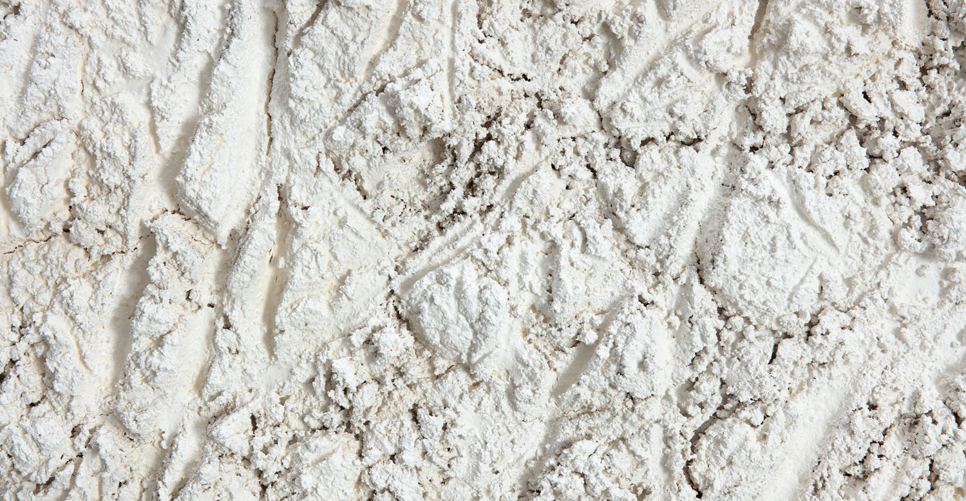
Notes:
Close-up from BOSCO SODI’s, Untitled, 2019

Slide 11
Installation View

Slide 13
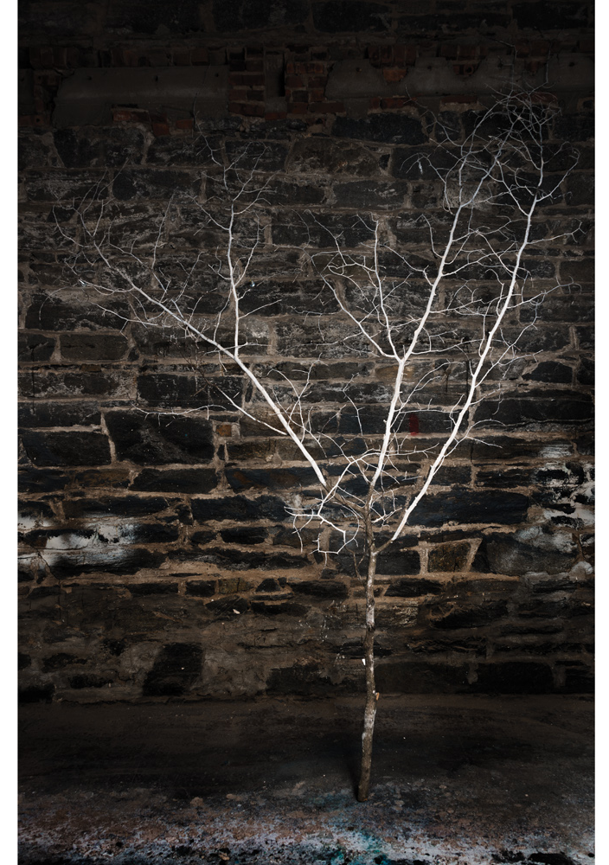
Vers l’Espagne Branch (2019)
Notes:
Vers l’Espagne Branch, 2019
pigment on Dibond
30.48 x 21.59 cm
12 x 8 ½ in.
Clay

Slide 14
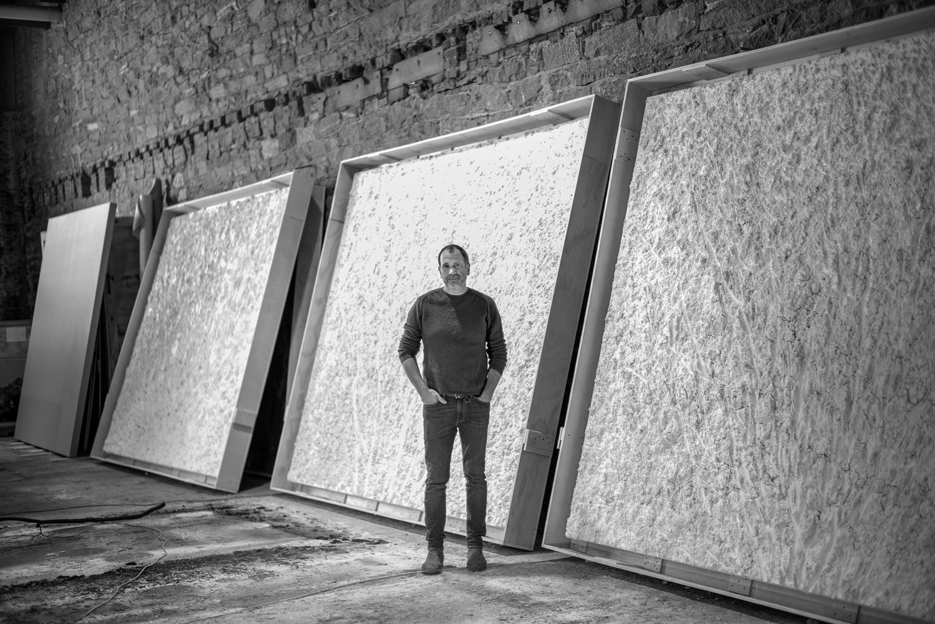
Notes:
Source: https://www.kasmingallery.com/exhibition/bosco-sodi--vers-lespagne/showroom
Bosco Sodi in his Red Hook Studio.
“Sodi mixes raw pigment with sawdust, wood, pulp, natural fibers, and glue to create the dense surfaces of the monochrome paintings. As the layers of material dry, structures form without the guidance or intervention of the artist. These fissured ‘landscapes’ are both products of the artist’s creative process and the unpredictable and chance in nature.” [Source: https://www.kasmingallery.com/artist/bosco-sodi]

Slide 15
Bosco Sodi:
A brief biography of the artist

Slide 16
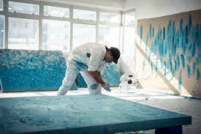
Bosco Sodi
Born in Mexico City in 1970
Works in Mexico, Barcelona, Berlin, and New York City
Has exhibited widely throughout the world
Leaves many of his paintings untitled, with the intention of removing any predisposition or bias for the viewer
Works weigh up to 300 lbs and take up to 2 months to dry
Sodi during 2-week residency in Hong Kong, December 2019
Notes:
Source: https://www.axel-vervoordt.com/gallery/artists/bosco-sodi
Image source: https://www.cobosocial.com/dossiers/five-encounters-with-antoni-tapies-by-bosco-sodi

Slide 17
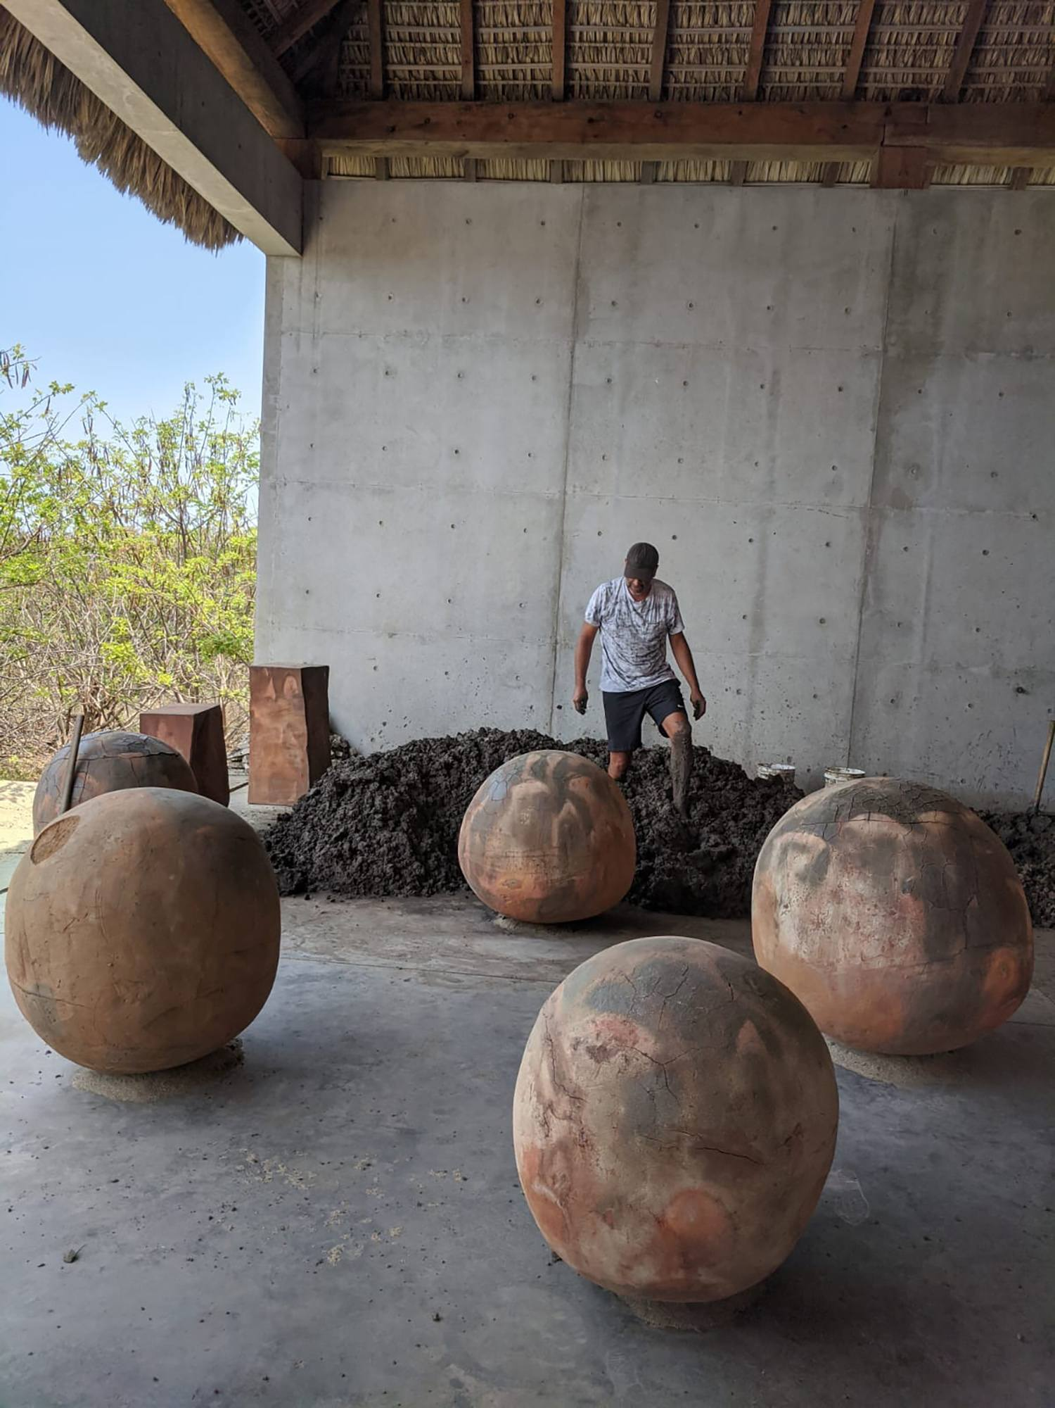
Sodi’s Creative Process
Uses raw, natural materials to create textured paintings, objects, and installations
Sodi has described his creative process as a “controlled chaos” that makes “something that is completely un-repeatable”
Japanese philosophy of wabi sabi, which prizes imperfection and chance happenings
Notes:
Source: https://ocula.com/artists/bosco-sodi/
The dense materiality of Sodi's paintings is achieved by his use of a mixture of pigments, pulp, sawdust, and glue that he applies to the canvas by hand, building layer upon layer. Once done, the paintings are left to dry over the course of three to five weeks; during this period, the thick surface cracks and hardens in unpredictable ways, thus creating a unique texture for each work.

Slide 18
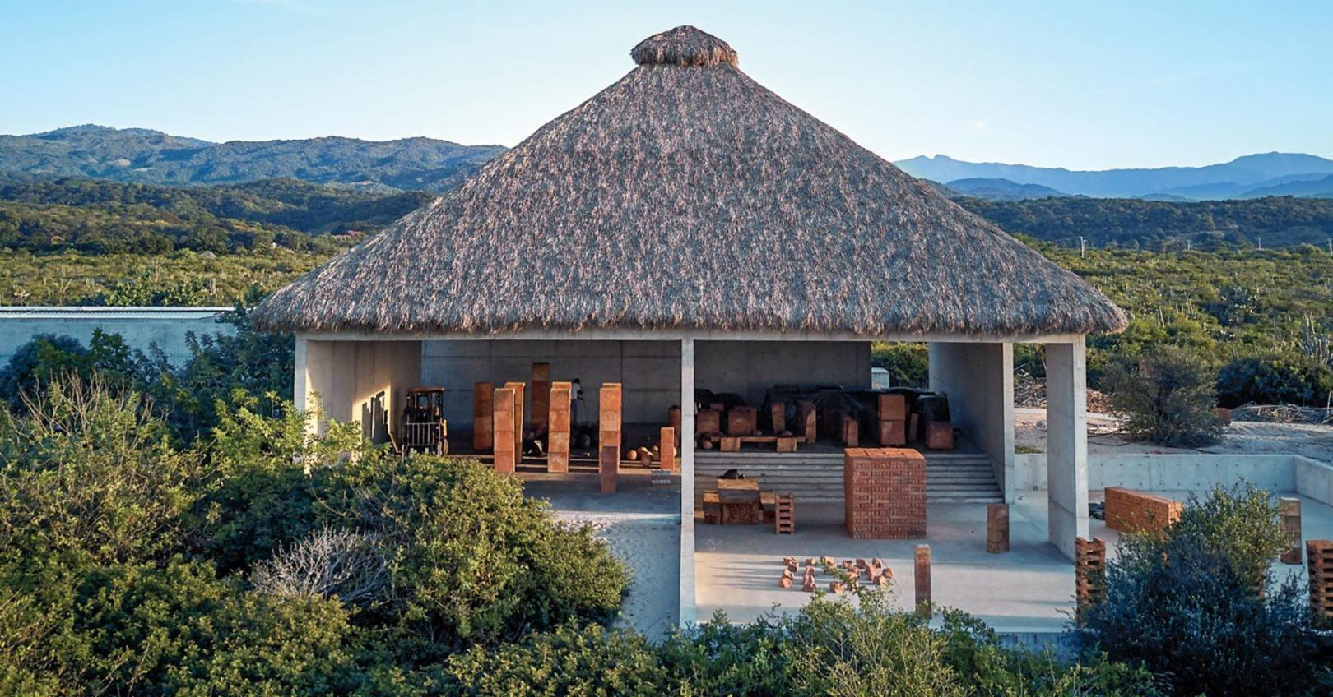
Casa Wabi
Notes:
Bosco Sodi’s palapa-style studio at Casa Wabi features concrete walls topped by a traditional thatched roof, a design conceived by Pritzker Prize–winning architect Tadao Ando.
When the COVID-19 pandemic hit, Sodi moved with his wife and 3 children to this location and spent much of the time in quarantine here.
PHOTO: Douglas Friedman
Image source: https://galeriemagazine.com/bosco-sodi-quarantine-art-mexico/

Slide 19
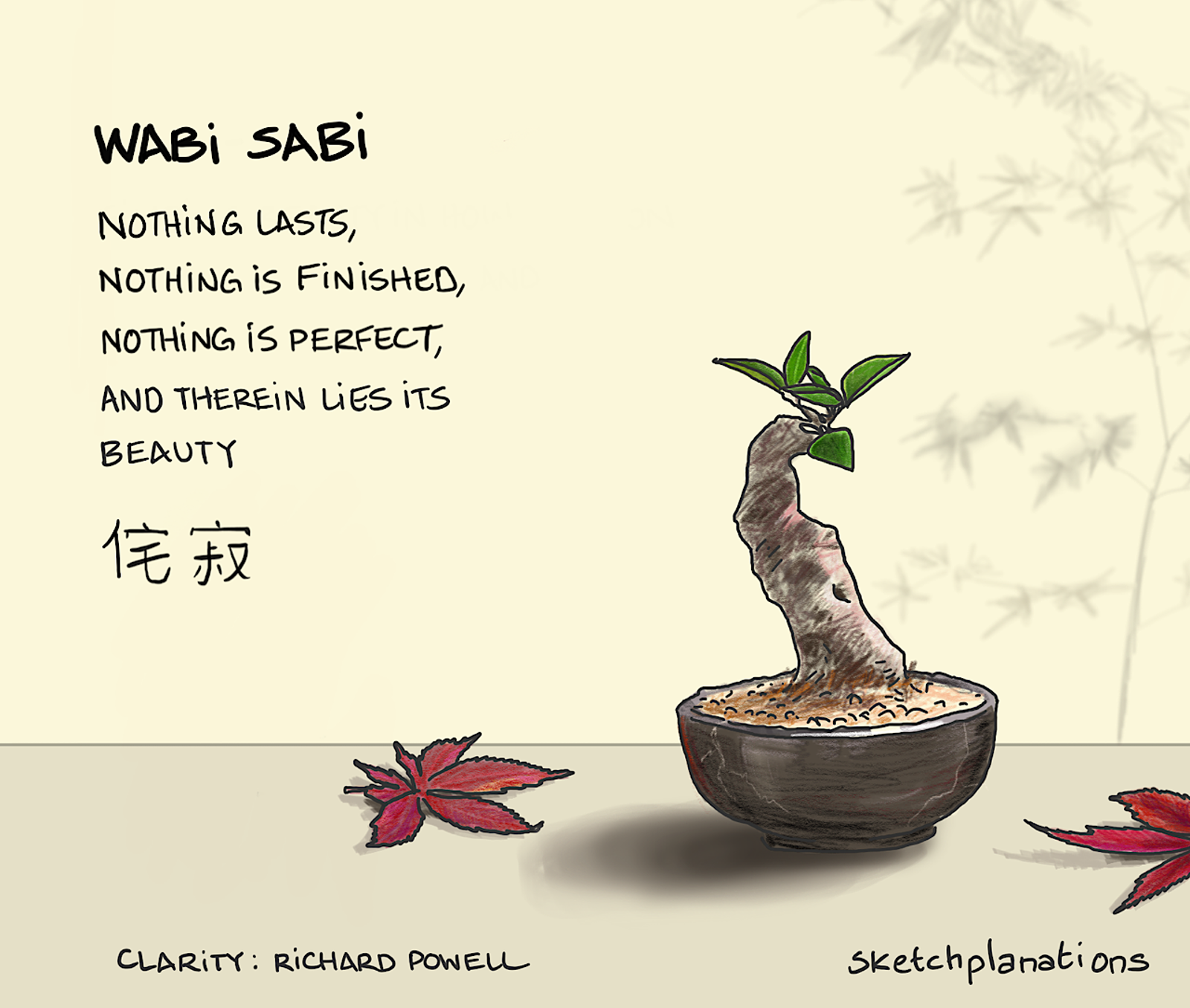
wabi sabi
Japanese aesthetic derived from Buddhist teachings
Embraces imperfection and impermanence
Principles include an appreciation of natural objects, forces of nature, asymmetry, and modesty
Notes:
Image source: https://sketchplanations.com/wabi-sabi

Slide 20
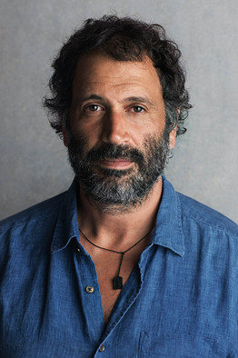
“It’s about embracing the accident, embracing the non-control, embracing the passing of time and working with organic materials.”
--- Bosco Sodi
Notes:
Quote source: http://www.artnet.com/artists/Bosco-Sodi/

