Slide 1
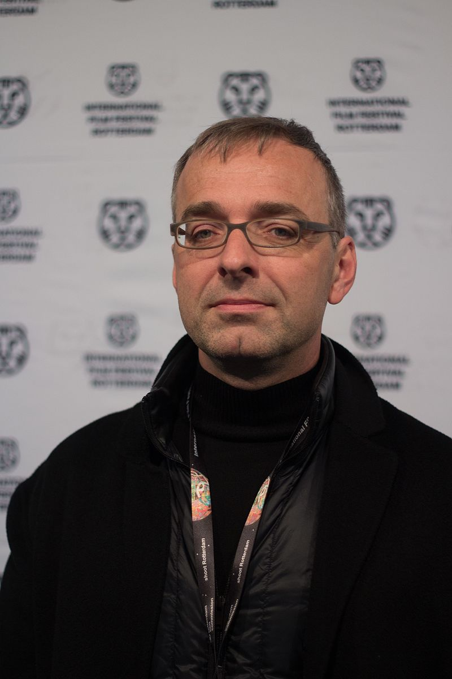
Looking at the Past and Present from multiple perspectives:
An Introduction to
David Claerbout
Notes:
Image source: By Vera de Kok - Own work, CC BY-SA 4.0, https://commons.wikimedia.org/w/index.php?curid=56416543
Overview:
Belgian artist David Claerbout (b. 1969, Kortrijk; lives in Antwerp and Berlin, Germany) has explored the conceptual framework of duration through use of film and digital photography throughout his career. His skilled manipulation of still and moving images appears to capture another dimension of existence, shifting between past and present. The element of sound is critical in many of his works, used as either a narrative device or a “guide” for the viewer to navigate the architectural space in the film. Claerbout’s oeuvre is characterized by a meticulous attention to production details, painstakingly created often over a period of years. The resultant works are immersive environments in which the viewer is invited to engage both philosophically and aesthetically.

Slide 2
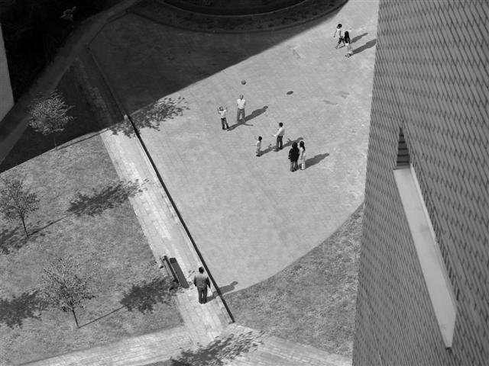
What’s happening in this picture?
Notes:
Source: http://www.artway.eu/content.php?id=1411&lang=en&action=show

Slide 3
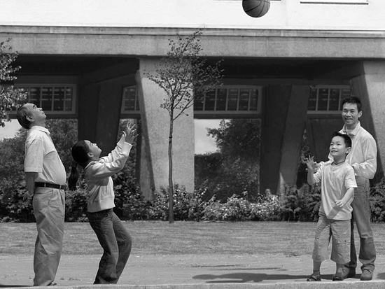
Let’s take a closer look… what’s going on?
Notes:
Source: http://www.artway.eu/content.php?id=1411&lang=en&action=show

Slide 4
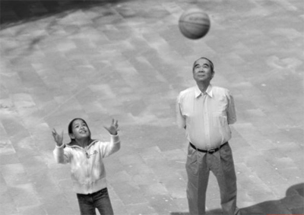
Even closer…
Notes:
Image Source: http://www.artway.eu/content.php?id=1411&lang=en&action=show
Source: https://collectordaily.com/david-claerbout-lightwork-sean-kelly/
Based on visual material notable only for its featureless banality—inside a clean and modern housing complex, three generations of a Chinese family stand in the courtyard, watching a child throw a ball into the air—the piece is another photographic deconstruction. But as the camera presents each person and grouping from multiple angles, the family unit gradually seems far stronger than the sum of the individuals. The piece is about latent possibilities—for simple joy, above all—that are seldom grasped as they happen. The black-and-white family drama unfolds silently over 25 minutes.

Slide 5
Sections of a Happy Moment (2007)
http://www.youtube.com/watch?v=D2NVu8S7c7U
Notes:
David Claerbout made thousands of photos of this moment and included 180 of them in the video Sections of a Happy Moment (http://www.youtube.com/watch?v=D2NVu8S7c7U) that in a loop starts over and over again.
In Sections of a Happy Moment (2007), Claerbout seems to ‘dissect’ a moment in the life of a Chinese family in the courtyard of a nondescript estate. A group of people are gathered around a ball suspended mid-air, all the faces turned towards it, smiling happily. Over the course of 25 minutes, this moment in time is analyzed from a multitude of different angles and perspectives.

Slide 6
David Claerbout
A brief biography

Slide 7
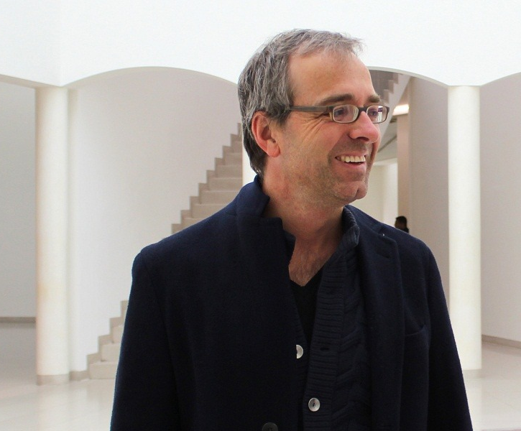
David Claerbout
Born 1969 in Kortrijk, Belgium
Education: 1992-1995 Nationaal Hoger Instituut voor Schone Kunsten, Antwerp
Originally trained as a painter
Became interested in photography and film during his painting studies
Has exhibited in many solo and group art shows
Lives and works in Antwerp, Belgium and Berlin, Germany
Notes:
Image source: http://www.widewalls.ch/artist/david-claerbout/artworks/

Slide 8
Claerbout’s work media
Claerbout is considered a photographer and video artist
Works in photography, video, sound, drawing and digital arts
Best known for large-scale video installations
Much of his work blends and overlaps with photography and film
Photo-graphy
Film

Slide 9
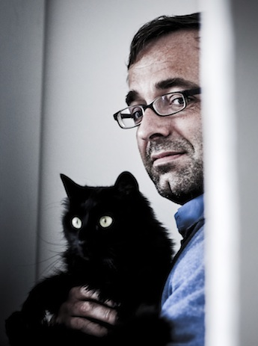
Themes in Claerbout’s work
Claerbout became increasingly interested in the concept of time when he took courses in photography
Many of Claerbout’s works examines the same place or event from multiple perspectives and viewpoints
Notes:
Image source: http://blogs.artinfo.com/artintheair/2014/06/03/david-claerbout-joins-sean-kelly-stable/

Slide 10
Some representative works
David Claerbout

Slide 11
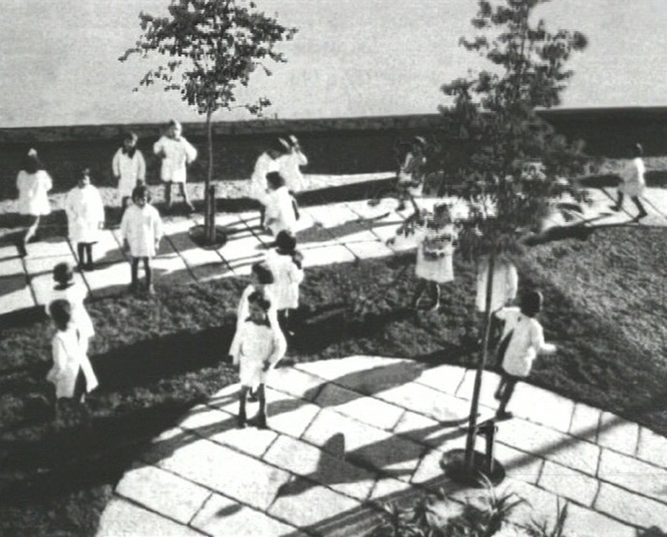
Kindergarten Antonio Sant'Elia, 1932 (1998)
Notes:
Source: http://davidclaerbout.com/Kindergarten-Antonio-Sant-Elia-1932-1998
Single-channel video projection, black & white, silent, 10 min loop This video is based on a photograph dating from 1932, taken at the opening of the new Antonio Sant’Elia kindergarten in Como, Italy. We see children playing in the school’s functionalist garden (designed by the architect Giuseppe Terragni). The light is cold and it seems as if the sun is low, creating the long shadows of early spring. The image of the children remains in between a spontaneously captured moment and a composed picture. The movement of the young trees suggests that the image is frozen, while it simultaneously continues to melt further into motion, as though undecided in which direction to go.

Slide 12
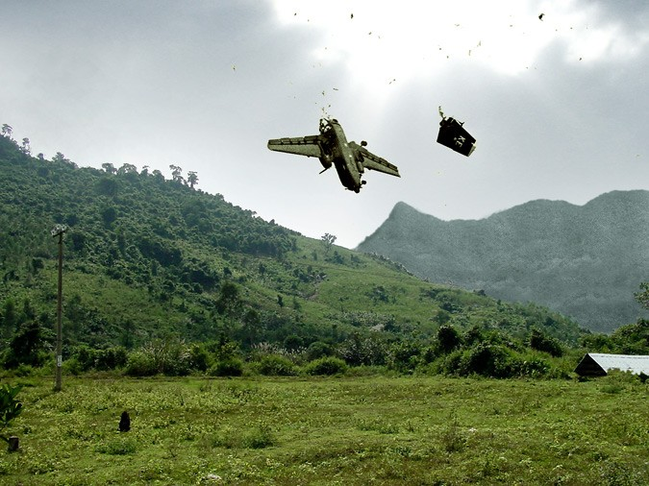
Vietnam, 1967, near Duc Pho (Reconstruction after Hiromishi Mine) (2001)
Notes:
Source: http://www.gms.be/files/images/ar/12/56/claerbout_vietnam_01.jpg
single channel video projection, mute, colour
In Vietnam, 1967, near Duc Pho (Reconstruction after Hiromishi Mine) (2001) time is suspended as an airplane caught by the camera moments before its crash, floats, the sunlight gently moving over a green and hilly landscape.

Slide 13
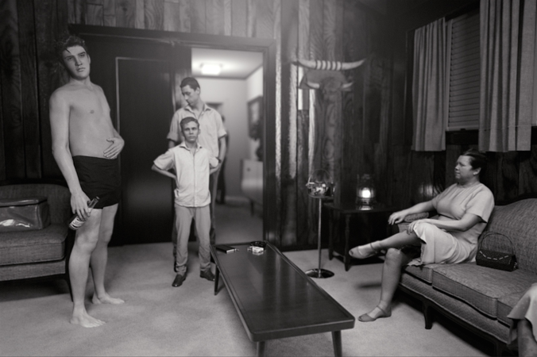
KING (after Alfred Wertheimer’s 1956 picture of a young man named Elvis Presley), 2015-2016
Notes:
Source: http://davidclaerbout.com/KING-after-Alfred-Wertheimer-s-1956-picture-of-a-young-man-named
single channel video projection, black & white, silent, HD animation, 10 min.

Slide 14
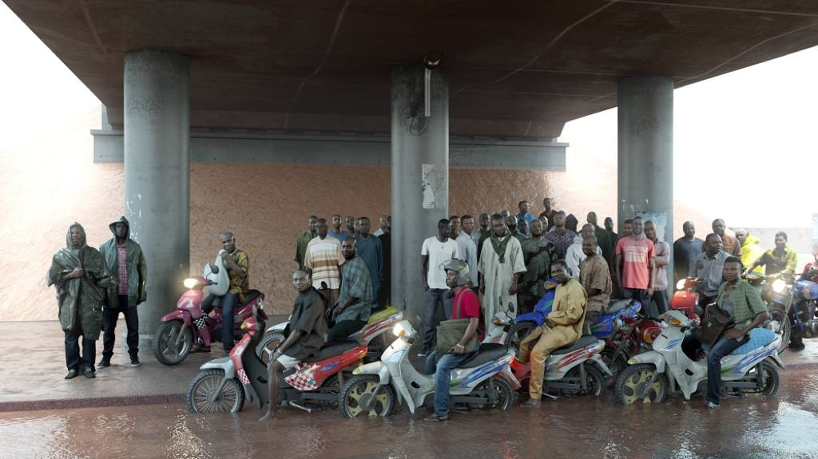
Oil workers (from the Shell company of Nigeria) returning home from work, caught in torrential rain, 2013
Notes:
Source: http://tettero.net/content/uploads/2013/10/Oil-workers-from-the-Shell-company-of-Nigeria-returning-home-from-work-caught-in-torrential-rain-David-Claerbout-2013-courtesy-of-the-artist-and-galleries-Yvon-Lambert-Micheline-Szwajcer-Hauser-Wirth.jpg
single channel video projection, HD animation, colour, silent, endless

Slide 15
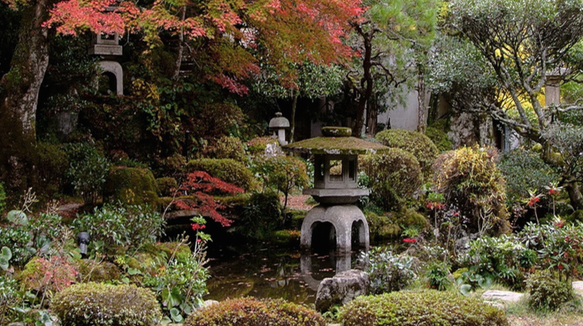
Radio Piece (Hong Kong), 2015
Notes:
Source: http://davidclaerbout.com/Radio-Piece-Hong-Kong-2015
single channel video projection, color, binaural sound over headphones, 11: 40 min.

Slide 16
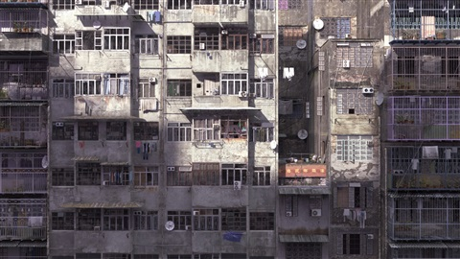
Radio Piece (Hong Kong), 2015
Notes:
Source: http://www.artnet.com/galleries/sean-kelly-gallery/artist-david-claerbout/

Slide 17
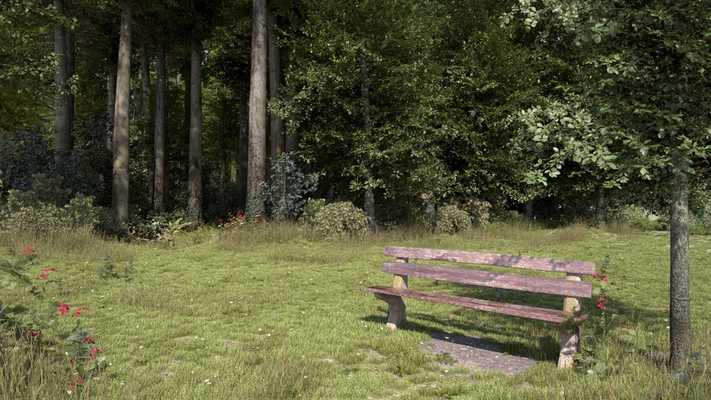
Travel, 1996-2013
Notes:
Image source: http://davidclaerbout.com/Travel-1996-2013
single channel video, HD animation, color, stereo sound, 12 min
This work is a good example of what one review describes as: “Claerbout’s oeuvre is characterized by a meticulous attention to production details, painstakingly created often over a period of years. The resultant works are immersive environments in which the viewer is invited to engage both aesthetically and philosophically.” (Source: http://blogs.artinfo.com/artintheair/2014/06/03/david-claerbout-joins-sean-kelly-stable/)
Entire 12-minute work and interview with Claerbout regarding this piece available at:: http://davidclaerbout.com/filter/work/Travel-1996-2013.
Claerbout’s video Travel, playing in the lower-level gallery, lasts only 12 minutes but they feel like an eternity. The camera ambles along a forest path, beside rushing streams, looking forward through archways of trees, toward a destination that is continually beyond. The 3D simulations of Nature did nothing but inspire me want to head outdoors in search of the real thing. (Source: https://collectordaily.com/david-claerbout-lightwork-sean-Kelly)

Slide 18
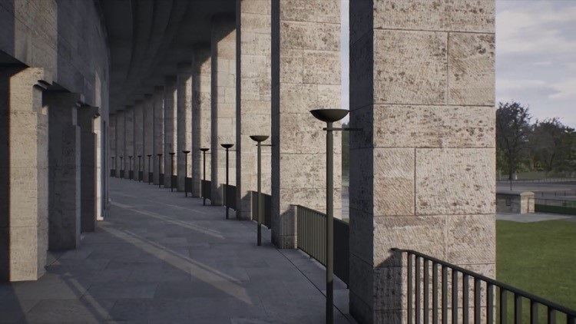
Olympia (The real time disintegration into ruins of the Berlin Olympic stadium over the course of a thousand years), 2016
Notes:
Source: http://www.artnet.com/artists/david-claerbout/olympia-the-real-time-disintegration-into-ruins-a-0fIbpHB1XYLiq8up5JetgQ2 Prints and multiples, Film, video, two channel video installation, color, stereo sound, HD animation, 1000 years.
Source: https://collectordaily.com/david-claerbout-lightwork-sean-kelly/
This page has extensive information on this work, with video excerpt: http://davidclaerbout.com/filter/work/Olympia-The-real-time-disintegration-into-ruins-of-the-Berlin-Olympic.
Claerbout’s newest video projections, Olympia (the real time disintegration of the Berlin Olympic stadium over the course of a thousand years) is a computer-graphics reconstruction of the Nazi masterpiece built by architects Werner and Walter March for the 1936 Olympic Games. Claerbout has modeled his virtual building on the actual one, as it exists in 2016, reproducing each stadium step and patch of grass. The camera crawls around the empty spaces below the stands. While it may appear as if nothing in the scene is changing, the piece is designed so that the computerized structure will slowly disintegrate over the course of 1,000 years (currently it is programmed for the next half-century.) This longue durée view of time is fitting for a piece about the folly of empires—Hitler believed that his leadership would begin Germany’s Thousand-Year Reich—and the far longer lives of buildings in stone.

Slide 19
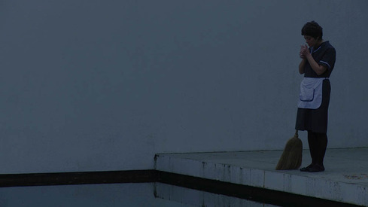
Sunrise (2009)
Notes:
Source: http://davidclaerbout.com/Sunrise-2009
single channel video projection, colour, stereo audio, 18 min In Sunrise (2009), Claerbout presents an 18-minute work in near-darkness, accentuating the dim tones by projecting the film on to a grey surface. For nearly the entire film a housemaid goes about her chores in the muted light of pre-dawn, finally departing the house and cycling through a dimly-lit landscape, In the early hours of the morning when it is still dark outside, a maid starts her work. She is getting the house ready for a new day. When she is finished with her task she leaves the still quiet house where the people have not yet risen, closes the door and goes away on her bicycle. She drives off into early morning sunlight while Rachmaninov's popular Vocalise is to be heard. The film ends at this point, and significantly starting the day, her day. The entire first part of the film is set in darkness. Despite that, it is possible to distinguish the contours of actions and architecture in simple geometric compositions, a feature allowed by the minimalist manner in which the house was built. The camera is using the architecture's functionalism to 'imprison' the choreography of the maid's movements in between surfaces and lines, a dominant form throughout the entire first part of the film. The house, reminiscent of Van der Rohe and Johnson, remains enveloped in darkness until the end of the film and it is portrayed as a fragile museum piece, as if it can no longer stand the bright light of modern future. Sunrise leaves us with conflicting feelings about 'the end' of the film. Although filmed as a classical end sequence it feels like a beginning.

Slide 20
The Quiet Shore (2011)

Slide 21
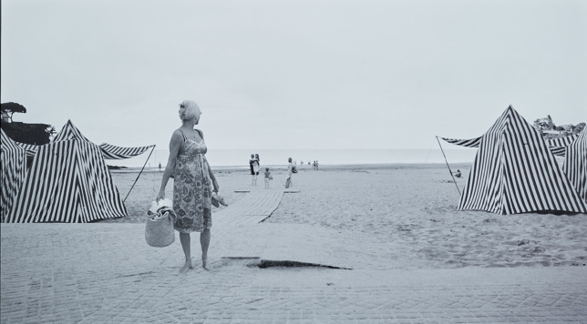
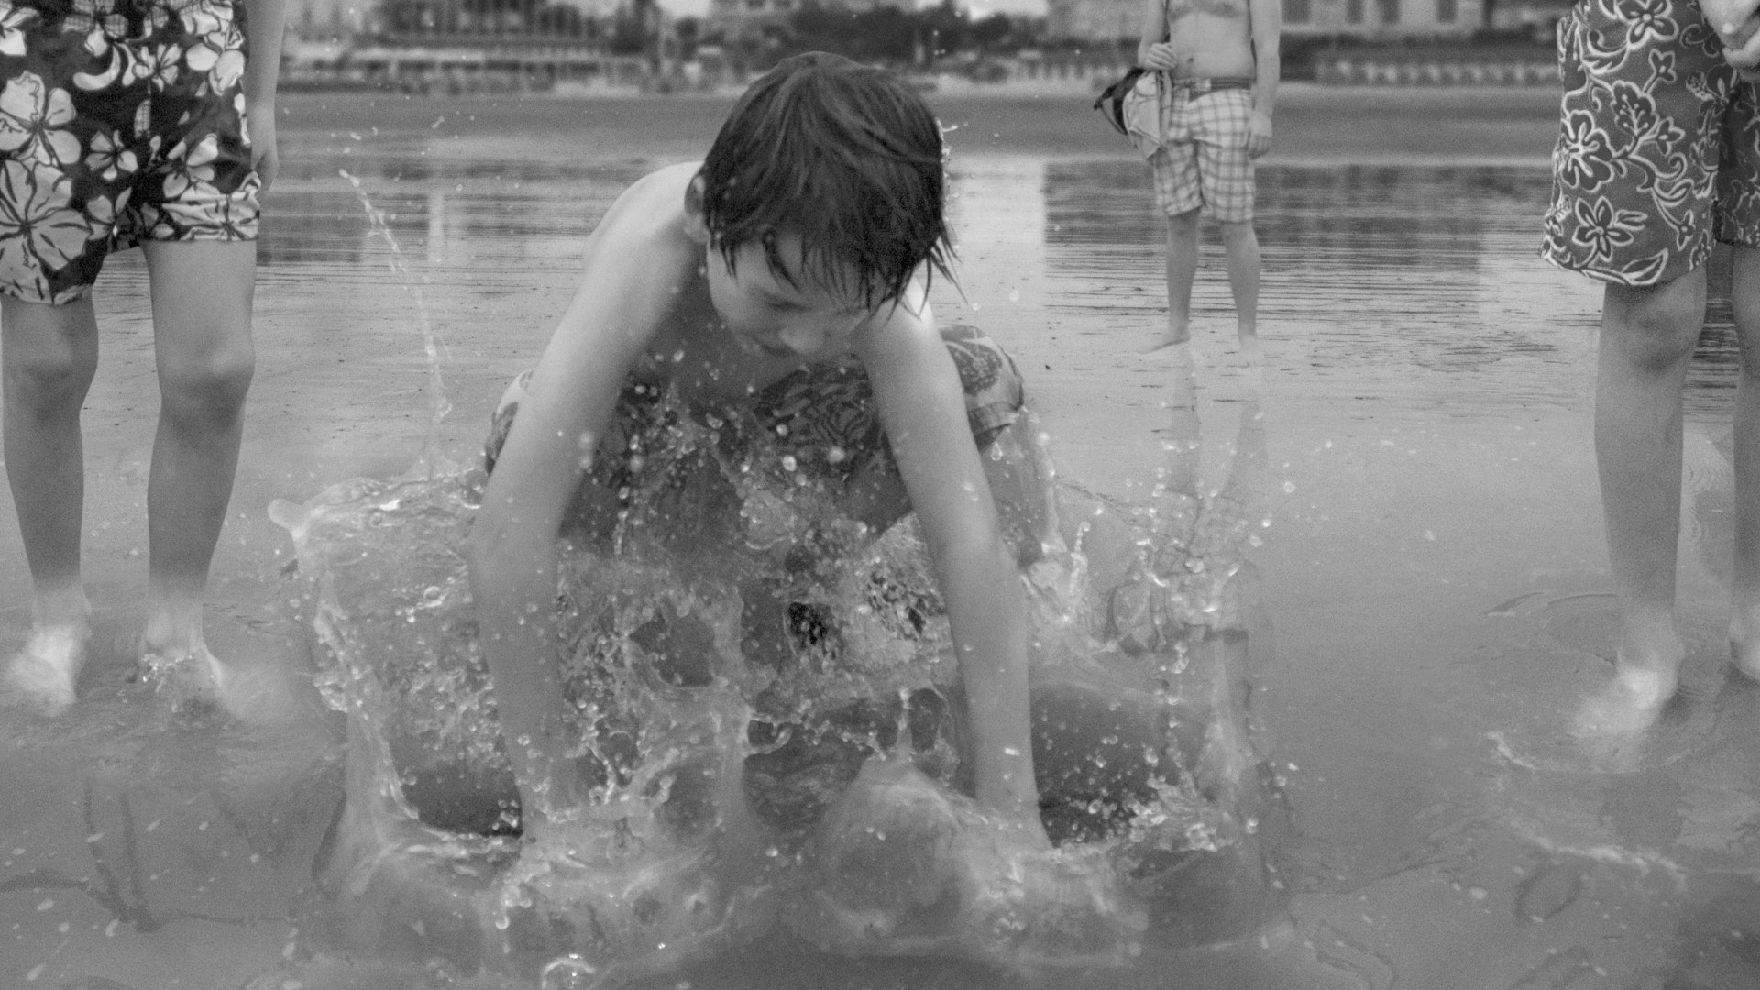
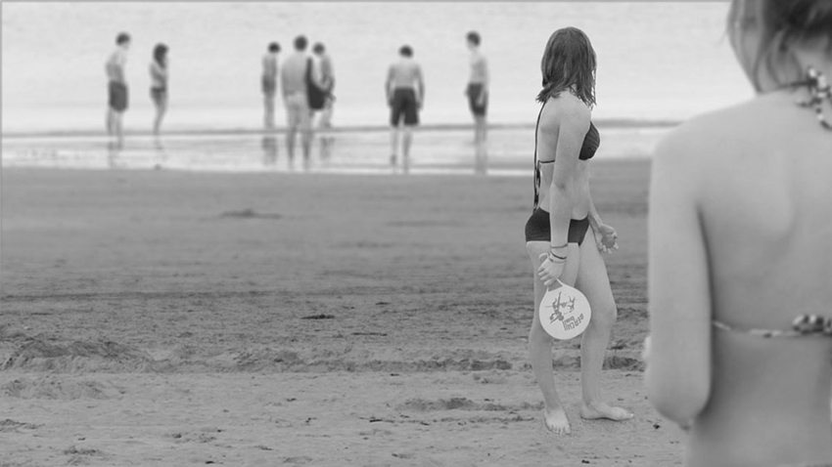
The Quiet Shore (2011)
Notes:
David Claerbout, The Quiet Shore, 2011 (video stills),single-channel video projection, 36:32 mins (looped), black and white, silent.
Source:
Set on the coastline of Brittany, France, The Quiet Shore (2011) is a 36-minute black-and-white film capturing scenes that range from moments of minute detail to panoramic expanses of coastal landscape. The viewer experiences, frame by frame, a single moment from a multitude of different perspectives and viewpoints.
The landscape of The Quiet Shore is photographed in Brittany, a region that is known to have the strongest tides in Europe. The beach is fascinating at low tide, when it is empty and the sand is still soaked in water, creating a shore that is temporarily so still it could almost reflect the world around it like a mirror. I think the fascination with this work came from the stillness of the silvery water, with silver itself relating to the history of photography. The shore has an icy look (you can see its temperature) despite the summer (you know its temperature) that is so clearly present through the attributes and people of the season. Among the villas surrounding the beach, there is one that inspired Alfred Hitchcock for his 1960 Psycho house. Today, this reflects back onto those villas, bringing cinema back to the margin of the scene, where it should be. None of my ideas come directly from film or literature (excerpt of an interview with Inka Graeve-Ingelman, Pinakothek der Moderne, Munich, "David Claerbout. uncertain eye", 2010 exhibition catalogue)

