Slide 1
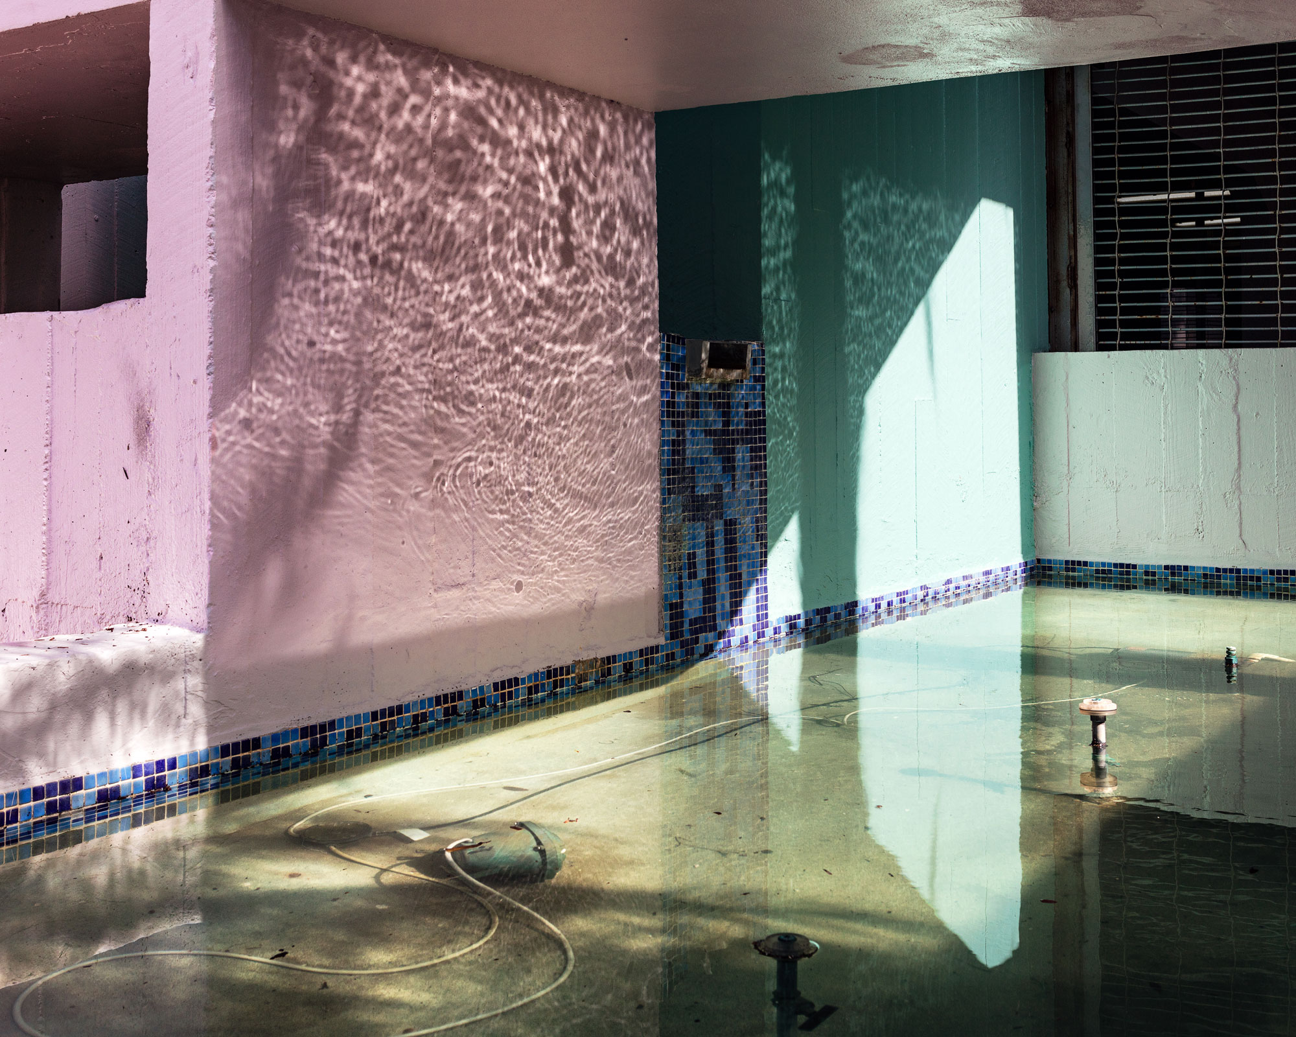
Rising Sea Levels: FloodZone
Anastasia Samoylova
Notes:
Image retrieved from: http://www.ira.usf.edu/CAM/exhibitions/2020_1_FloodZone/images/Anastasia_Samoylova,_from_the_FloodZone_series,_2016-2019.jpg

Slide 2
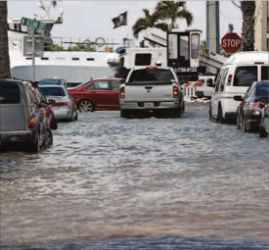
VTS
Notes:
Article: https://www.pressreader.com/usa/tampa-bay-times/20191104/281509342991344
Picture Credit: Taimy Alvarez, South Florida Sun Sentinel
Engage the entire class in a conversation about the photograph by asking the following questions:
What is going on in this picture?
What do you see that makes you say that?
What more can we find?

Slide 3
A Glimpse of the ‘New Normal’ in S. Florida
Notes:
Article: https://www.pressreader.com/usa/tampa-bay-times/20191104/281509342991344
Picture Credit: Taimy Alvarez, South Florida Sun Sentinel
Click on the hyperlinked title to display an article published on November 4, 2019 in the Tampa Bay Times. Take turns having students volunteer to read aloud sections of the article. After each section pause and ask for a student to summarize the section.

Slide 4
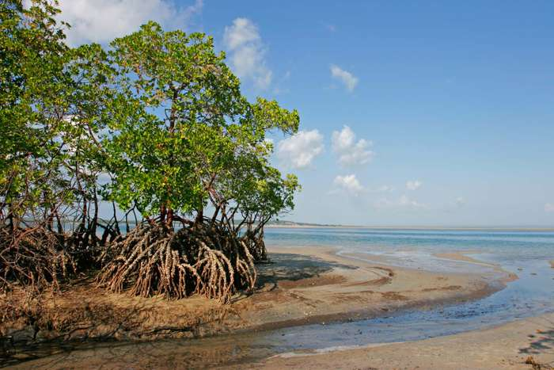
Think-Pair-Share
“Living in Miami is bittersweet: it looks and feels like a paradise, but the only secure roots belong to mangrove trees.” - Anastasia Samoylova
Notes:
Quote retrieved from: https://www.anasamoylova.com/work-1#/floodzone/
Picture source: https://www.britannica.com/plant/mangrove
Have students engage in a think-pair-share around the quote by photographer Anastasia Samoylova.

Slide 5
FloodZone
“FloodZone aims to manifest the precarious psychological state of lives that teeter between paradise and catastrophe.”
- Anastasia Samoylova
Notes:
Image retrieved from: http://www.ira.usf.edu/CAM/exhibitions/2020_1_FloodZone/images/Anastasia_Samoylova,_from_the_FloodZone_series,_2016-2019.jpg
Instruct students that they will now learn about the photography of Miami-based photographer Anastasia Samoylova. Her work entitled, “FloodZone” focuses on changes in nature and the affects it has on society. Have students read a short article highlighting the exhibition “FloodZone”The article can be found by clicking on hyperlink in the presentation or copying and pasting the link below in a new browser: https://www.mysterytribune.com/floodzone-landscape-photography-of-anastasia-samoylova/ After reading the article, have students ponder a quote from the artist: “FloodZone aims to manifest the precarious psychological state of lives that teeter between paradise and catastrophe.”

Slide 6
Research Project
Venice, Italy
Guangzhou, China
Mumbai, India
Osaka, Japan
Shanghai, China
Hong Kong
Ho Chi Minh City, Vietnam
Bangkok, Thailand
Alexandria, Egypt
Rio de Janeiro, Brazil
Miami, USA
New Orleans, USA
New York City, USA
Notes:
Image retrieved from: http://www.ira.usf.edu/CAM/exhibitions/2020_1_FloodZone/images/Anastasia_Samoylova,_from_the_FloodZone_series,_2016-2019.jpg
Have students research rising sea levels. Ask them to select a city that is impacted/projected to be impacted by rising sea levels. Have students research the following:
Rising sea levels
Global warming
Extent of the problem for their select city
Impact the rising sea levels is/will bring to living things/ecosystem
Measures being taken/that can be taken to counter the rising sea levels for their select city
Students can share their work in any medium desired (ppt, oral presentation, artwork, podcast). Encourage critical analysis of the topic and creativity in the final product. Have students share their work with the class.
Select websites to assist with project:
https://thecityfix.com/blog/5-major-cities-threatened-climate-change-sea-level-rise-emily-cassidy/
https://www.weforum.org/agenda/2019/01/the-world-s-coastal-cities-are-going-under-here-is-how-some-are-fighting-back/
https://www.theguardian.com/cities/ng-interactive/2017/nov/03/three-degree-world-cities-drowned-global-warming
https://www.theguardian.com/cities/2017/nov/03/miami-shanghai-3c-warming-cities-underwater
https://www.nytimes.com/interactive/2019/10/29/climate/coastal-cities-underwater.html
https://www.cnn.com/2019/10/30/world/rising-sea-cities-study-intl-hnk-scli-sci/index.html

