Slide 1
Civil Rights Activists:
The Heart of the Fight

Slide 2
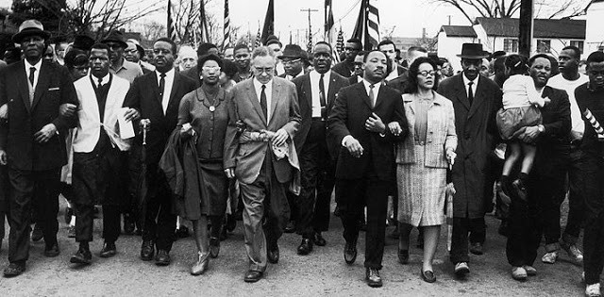
Learning Objectives
Examine the 14th Amendment to the U.S. constitution and its significance in Black peoples’ fight against racist and discriminatory laws.
Explain ways in which Black people used legal, cultural, social, and economic means to fight political and social injustices.
Interpret through primary sources the effects of racist and discriminatory laws and practices on Black people in the United States.

Slide 3
On January 14, 1963, George Wallace was inaugurated as the governor of Alabama.
List two things in this recording you think are important.
List two things this recording tells you about life in the United States at the time it was made.
Notes:
Teacher: This lesson begins with an excerpt of George Wallace’s inaugural speech as governor of Alabama. Wallace delivered the speech January 14, 1963 in the state’s capitol, Montgomery.
Direct students to listen to the speech. Encourage students to use their background knowledge as they listen to the content of the speech. Ask students to:
List two things in this recording you think are important.
List two things this recording tells you about life in the United States at the time it was made.
Video link: https://www.youtube.com/watch?v=6C-kBVggFrs

Slide 4
14th Amendment of the U.S. Constitution
Citizenship Rights, Equal Protection, Apportionment, Civil War Debt
Passed by Congress June 13, 1866. Ratified July 9, 1868.
Section 1.
All persons born or naturalized in the United States, and subject to the jurisdiction thereof, are citizens of the United States and of the State wherein they reside. No State shall make or enforce any law which shall abridge the privileges or immunities of citizens of the United States; nor shall any State deprive any person of life, liberty, or property, without due process of law; nor deny to any person within its jurisdiction the equal protection of the laws.
4
Notes:
[Note: “The Fourteenth Amendment addresses many aspects of citizenship and the rights of citizens. The most commonly used -- and frequently litigated -- phrase in the amendment is "equal protection of the laws", which figures prominently in a wide variety of landmark cases, including Brown v. Board of Education (racial discrimination).”]
Teacher: Explain to students the 14th Amendment to the U.S. constitution was passed in 1866 and ratified in 1868. Ask students:
What major event in U.S. history concluded a year prior to the passing of the 14th Amendment? (Answer: The Civil War ended May 9th, 1865.)
Read section 1 of the 14th Amendment (add emphasis to the underlined area). Ask students:
What does it mean no state can “…deprive any person of life, liberty, or property, without due process of law?”
What do you perceive is the significance of “…equal protection of the laws?”
After a brief discussion centered on the questions above, remind students that Wallace delivered his inaugural speech in 1963, almost one hundred years after the ratification of the 14th Amendment. Ask students:
When Governor Wallace stated, “segregation now, segregation tomorrow, segregation forever,” is he supporting a state law in violation of the 14th Amendment to the constitution? Why or why not?
Sources:
https://www.constitutioncenter.org/interactive-constitution/amendment/amendment-xiv
https://www.law.cornell.edu/constitution/amendmentxiv#:~:text=14th%20Amendment%20The%20Fourteenth%20Amendment%20addresses%20many%20aspects,wide%20variety%20of%20landmark%20cases%2C%20including%20Brown%20v.

Slide 5
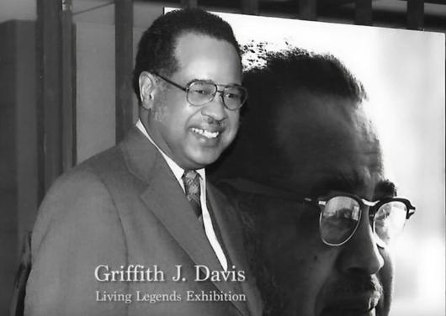
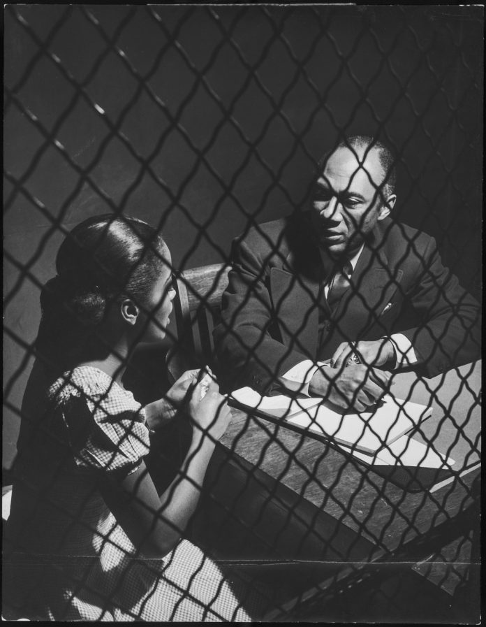
Photographing the Fight for Human Rights: Images by Griffith J. Davis
5
Notes:
Teacher: Explain to students Griffith J. Davis’s photography captured some of the most influential events of the Civil Rights movement. He was bold in his photography in that he attempted to capture the Black experience. His photos provide us with meaningful insight of this historical period.
Images: (Left) Griffith J. Davis Photographs and Archives
(Right) Euclid Taylor was a prominent attorney in Chicago’s black community. For a crime story for Ebony in 1948, Davis photographed Taylor interviewing a client in prison.
Sources: https://wusfnews.wusf.usf.edu/local-state/2020-10-13/photojournalist-griffith-j-davis-honored-with-lifetime-achievement-award
https://share.america.gov/griff-davis-life-in-photography-and-diplomacy/

Slide 6
Griffith J. Davis (Bio)
Born in 1923; parents were college educated
Graduated from Morehouse College and Columbia University
Served in the Army as a Buffalo Soldier during WWII
Served in the Foreign Service with U.S. Agency for International Development (USAID) in Liberia
Photojournalist (Africa and the United States)
Inspired by United Nations, Liberia and Ethiopia (Free Nations for Black people), and the Civil Rights Movement
Friend of Langston Hughes (Poet) and Martin Luther King, Jr.
Notes:
Teacher: Review Davis’s biographical information. Ask students:
• What do you notice most about Davis’s life?
How do you think these experiences shaped his world view?
Image source: https://www.facebook.com/griffdavis418/photos/140815560857617

Slide 7
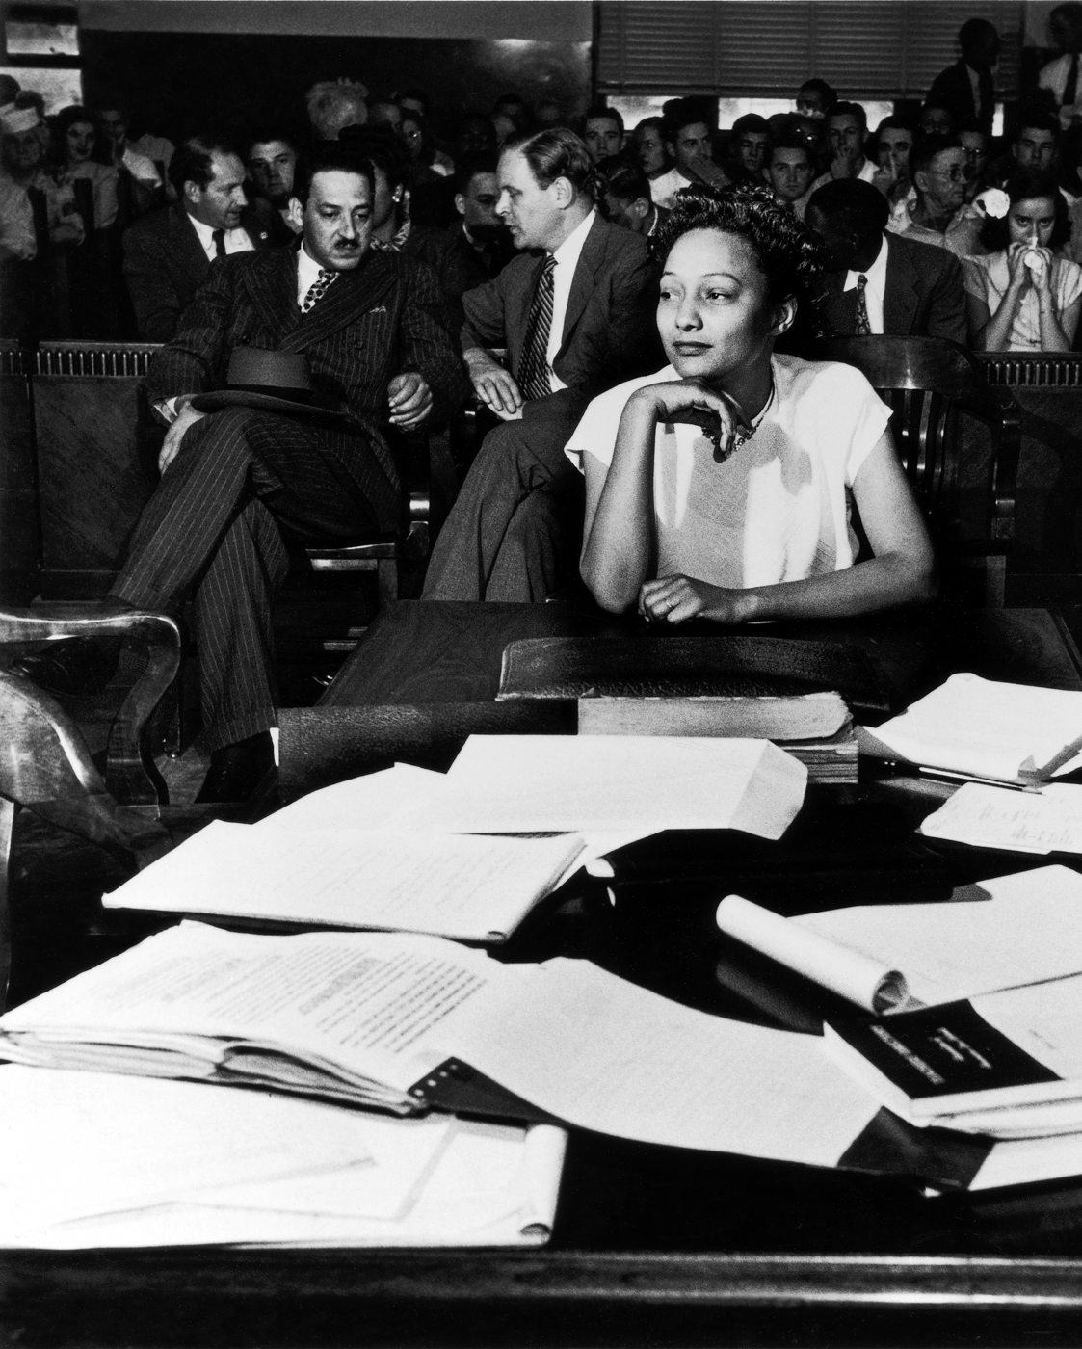
In the 1940s and 1950s, court cases increasingly challenged states’ segregation laws in schools.
Thurgood Marshall (back left), the first Black man appointed to the Supreme Court of the United States, is pictured with Ada Lois Sipuel (front) in a court case against the University of Oklahoma School of Law in a 1948 discrimination suit.
Notes:
Teacher: Look closely at the picture and answer questions: What is going on in this picture? What do you see that makes you say that? What more can you find?
(First bullet) In the 1940s and 1950s, Blacks in the United States increasingly used the legal system to challenge states’ segregation laws in schools.
(Second bullet) Thurgood Marshall was a Black attorney leading civil rights activist, and the first Black Justice in the Supreme Court of the United States. He used the legal system to challenge racist and discriminatory laws and practices. He argued 32 cases before the Supreme Court of the United States and won 29. The photo depicted in the slide captures Thurgood Marshall (back left) with Ada Lois Sipuel (front) during a court case against the University of Oklahoma School of Law in a 1948 discrimination suit. Sipuel won the case and attended law school. Thurgood Marshall is most known for the 1954 case Brown versus Board of Education of Topeka. This landmark case was considered Marshall’s greatest victory as a civil-rights lawyer. A group of Black parents whose children were required to attend segregated schools filed a class-action lawsuit. The Supreme Court unanimously ruled that “separate educational facilities are inherently unequal.”
Why was it an effective strategy to challenge segregation in schools?
Source: https://www.history.com/topics/black-history/thurgood-marshall
Image Source: Griff Davis photographed future Supreme Court justice Thurgood Marshall (rear, left) representing Ada Lois Sipuel (front) against the University of Oklahoma School of Law in a 1948 discrimination suit. (© Griff Davis)
https://share.america.gov/griff-davis-life-in-photography-and-diplomacy/

Slide 8
“Harlem” (1951)
By: Langston Hughes
What happens to a dream deferred?
Does it dry up like a raisin in the sun? Or fester like a sore—
And then run?
Does it stink like rotten meat? Or crust and sugar over—
like a syrupy sweet?
Maybe it just sags like a heavy load.
Or does it explode?
Notes:
Teacher: Explain to students that Langston Hughes was an American writer and poet. He used artistic expression in poetry and novels to communicate Black history and the Black experience in the United States, but he wrote for a general audience, seeking to convey his ideas in emotional, easily-understood phrases that nevertheless had power behind them. Hughes navigated cultural forms to advocate for social justice of the Black community.
Direct students to the poetry analysis worksheet. Read “Harlem” together aloud. Ask students to reflect on what they just read and consider the content and feelings captured in the poem as they complete the worksheet.
[If time permits, discuss as a class students’ responses.]
Source: https://www.thoughtco.com/biography-of-langston-hughes-4779849
Poem source: https://www.poetryfoundation.org/poems/46548/harlem
Image Information: Griffith J. Davis (left) and Langston Hughes (right)
Image source: https://alivetampabay.com/arts/trailblazers-griffith-j-davis-and-langston-hughes/

Slide 9
Martin Luther King Jr. used social and economic means to fight racist policies, laws, and practices (e.g. Montgomery bus boycott)
In March 1957, Vice President Richard Nixon met Martin Luther King Jr. for the first time in Ghana.
This meeting was not acceptable in the United States at the time; consequently, the photo could not be published in the US.
Notes:
Teacher: Direct students to look at the picture. Ask students:
• Who do you see in the picture?
• What is going on in this picture?
• What do you see that makes you say that?
• What more can we find?
After a discussion, inform students Martin Luther King, Jr. was the son of educated parents. He graduated from Morehouse College and studied at Crozer Theological Seminary. Social activists in Montgomery elected King as their leader for the Montgomery bus boycott, launching King into the national spotlight. His skillful rhetoric along with his inspiring personality shaped much of the Civil Rights movement.
(Bullet one) Martin Luther King Jr. used social and economic means to fight racist and discriminatory policies, laws, and practices. He became a prominent leader in the Civil Rights movement.
(Bullet two) During a celebration of Ghana’s independence in March 1957, Davis captured this photo of then–Vice President Richard Nixon speaking with Martin Luther King Jr. (Both men’s wives are also in the photo.)
(Bullet three) This meeting was not acceptable in the United States at the time. have been too volatile to have taken place in the United States, so the photo was not published there at the time.
Source: https://share.america.gov/griff-davis-life-in-photography-and-diplomacy/
Image Source: https://share.america.gov/griff-davis-life-in-photography-and-diplomacy/
Source: https://www.britannica.com/biography/Martin-Luther-King-Jr/The-Montgomery-bus-boycott

Slide 10
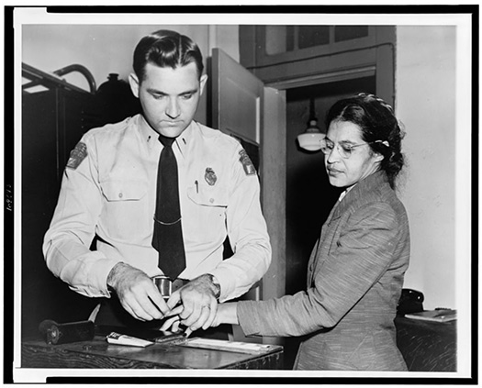
On the evening of December 1, 1955, Rosa Parks, was arrested for disobeying an Alabama law requiring black passengers to relinquish seats to white passengers when the bus was full.
Her arrest sparked a 381-day boycott of the Montgomery bus system and led to a 1956 Supreme Court decision banning segregation on public transportation.
10
Notes:
Teacher: On Dec. 1, 1955, Rosa Parks was arrested when she refused to surrender her seat on a Montgomery, Alabama, bus to a white passenger. The arrest led to the Montgomery Bus Boycott, a seminal event in the U.S. Civil Rights Movement, and was a defining moment in Parks' long career as an activist. We know Parks’ story well, but often overlooked are her thoughts and feelings after this event occurred.
Direct students to the Rosa Parks’ reflections primary source analysis worksheet. Students should discuss questions and answers in small groups.
[Note to teacher: Read the document aloud using affective emphasis.]
Image Source: https://www.loc.gov/item/94500293/
Source: https://www.loc.gov/item/today-in-history/december-01/

Slide 11
“Glory” by John Legend and Common (Dec 2014)
Reflection:
Consider what you learned about the 14th Amendment to the U.S. Constitution and the civil rights activists (Thurgood Marshall, Langston Hughes, Rosa Parks) while listening to the song and reading the lyrics.
Questions:
What do you perceive has changed?
What has remained the same?
Notes:
Teacher: This is a reflection activity focused on the song “Glory” by John Legend and the rapper Common. Ask students:
Consider what you learned about the 14th Amendment to the Constitution and the civil rights activists (Thurgood Marshall, Langston Hughes, Rosa Parks) while listening to the song and reading the lyrics.
What do you perceive has changed?
What has remained the same?
Video link: https://www.youtube.com/watch?v=HUZOKvYcx_o

