Slide 1
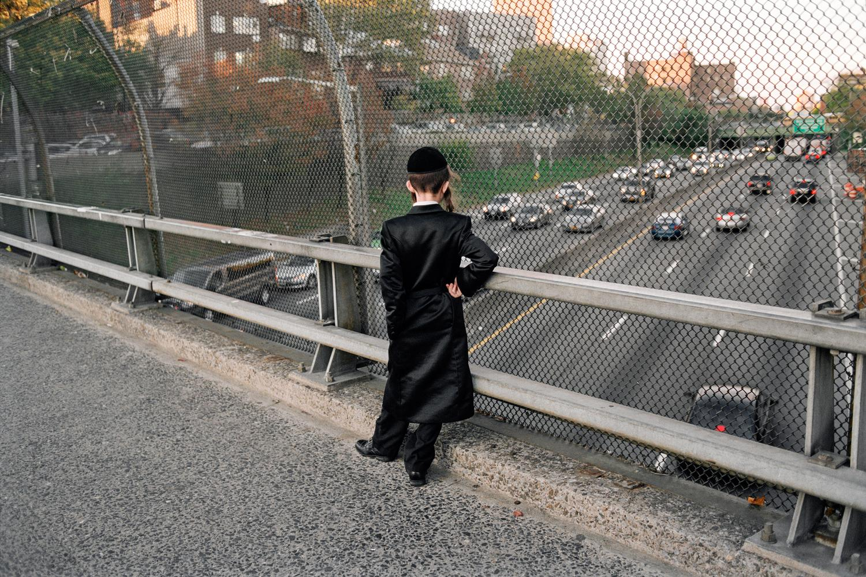
Hasidic Jewish Culture through the Lens of Guy Greenberg

Slide 2
Bell Ringer: Answer the questions…
1.What is culture? What are examples of your unique culture?
2. What is assimilation? How are different cultures assimilated into the bigger American culture?
Notes:
Display this slide as students come into the room. Tell them they need to get a piece of paper and answer the questions.
Allow students 5 minutes after the bell rings to answer the questions then 3 minutes to share with their group.
Ask for volunteers to share their answers with the class. The teacher should write their definitions on the board.
Finally, the teacher should share an example from their life and give proper definitions if students are struggling.

Slide 3
An Indian Fable...
Notes:
Tell students the Indian fable, “The Blind Men and the Elephant”
Six blind men came upon an elephant. They proceeded to describe it based upon the part that they were touching.
trunk = snake
side = wall
tail = tickly brush
ears = smooth carpet
tusks = hard as nails
legs = strong tree
All of them were right in some small way --- they were all “seeing” the elephant from their perspective. But they were also all missing critical pieces of information.
That’s what our “lens” do --- provide us with a way of seeing the world through our own filters, our own experiences.

Slide 4
Agenda : Looking Through Your “Lens”
→ Everybody has different experiences that make them unique!
→ When we look at art, we use our “lens” (different life experiences/culture) and we all see something different.
→ We are going to use our own lenses to look at photographs then learn about Hasidic Jewish Culture through the lens of contemporary artist Guy Greenberg.
Notes:
Examples of how one’s “lens” can impact our perceptions:
whether one grew up with siblings or not; visited other countries; can speak multiple languages; have an extended family or a nuclear one.

Slide 5
What do you see in the next artworks?
→ Look through your lens and write down what you see.
→ Simple words are ok!
→ You have ~1 minute for each photo.
For each photo, note:
→ What are the people doing?
→ What is happening?
→ Where is the scene taking place?

Slide 6
Notes:
Boy on BQE Overpass, 2016
This photograph was taken by Guy Greenberg in his study of Hasidic Jews in New York City. How has the artist juxtaposed modernity and tradition?

Slide 7
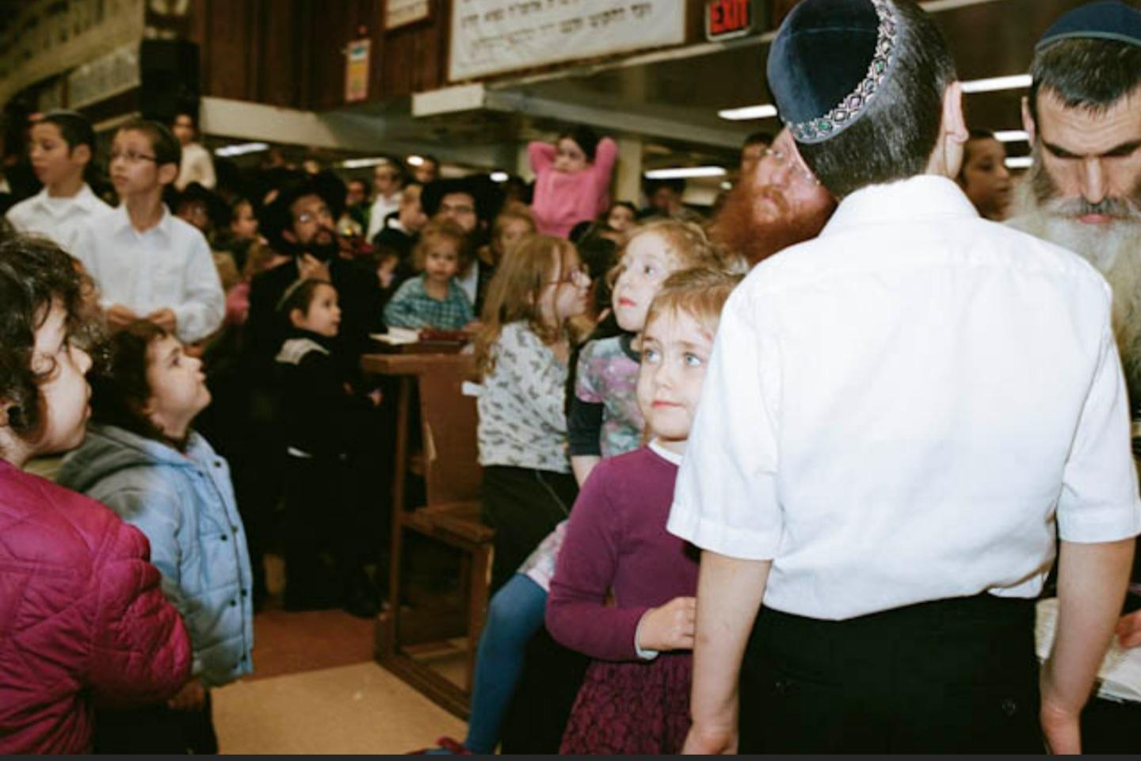
Notes:
Explain that this scene is taking place in a yeshiva (school).

Slide 8
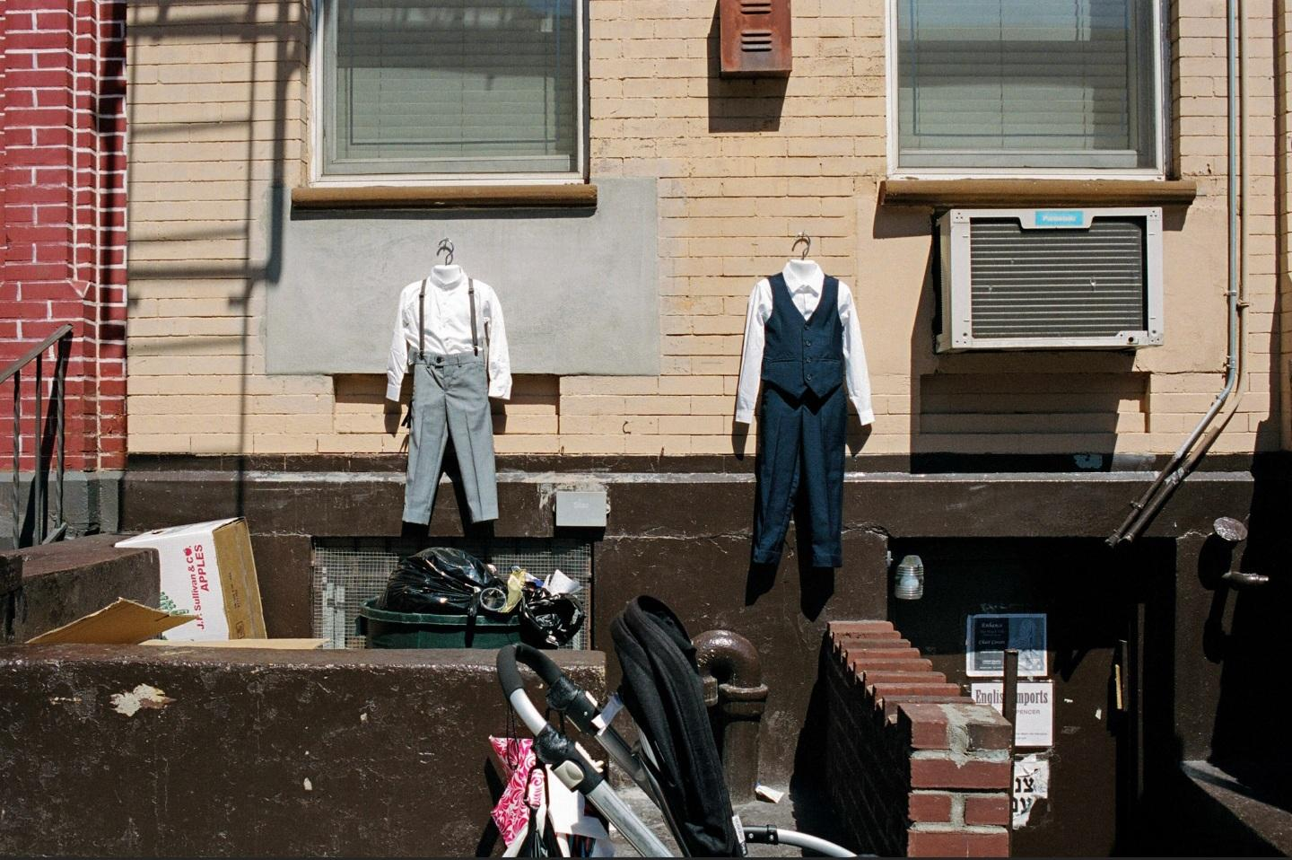
Notes:
Guy Greenberg, Tailor, 2016.

Slide 9
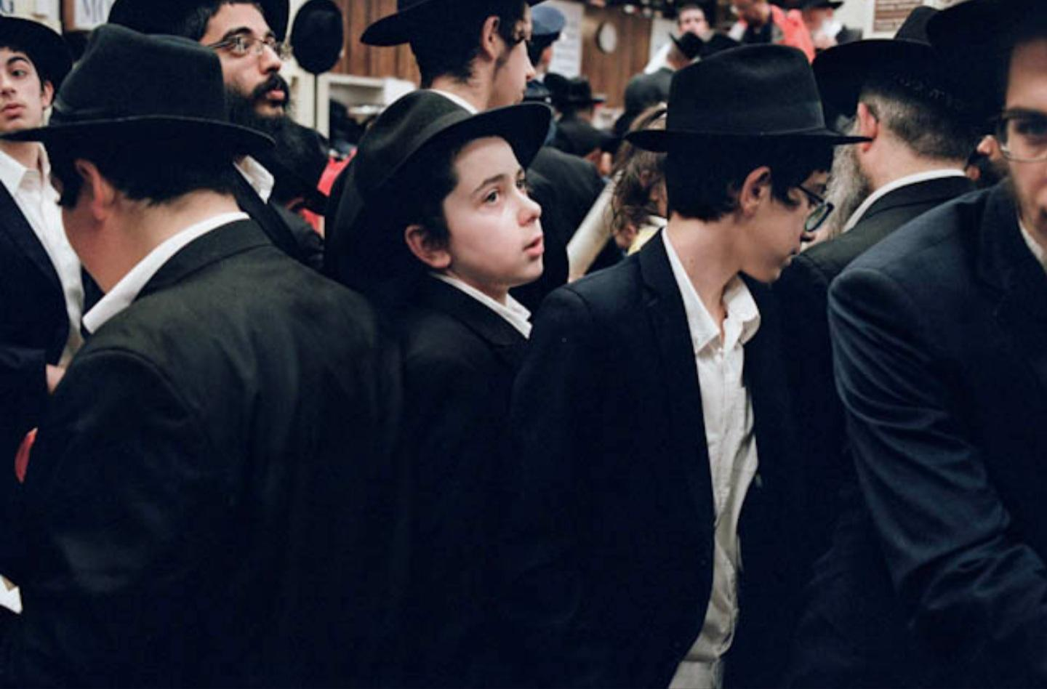
Notes:
Guy Greenberg, Boys in Shul, 2018. Courtesy of the artist.
The boys are wearing traditional clothes (some have payots, or sidelocks) and are at a shul (synagogue).

Slide 10
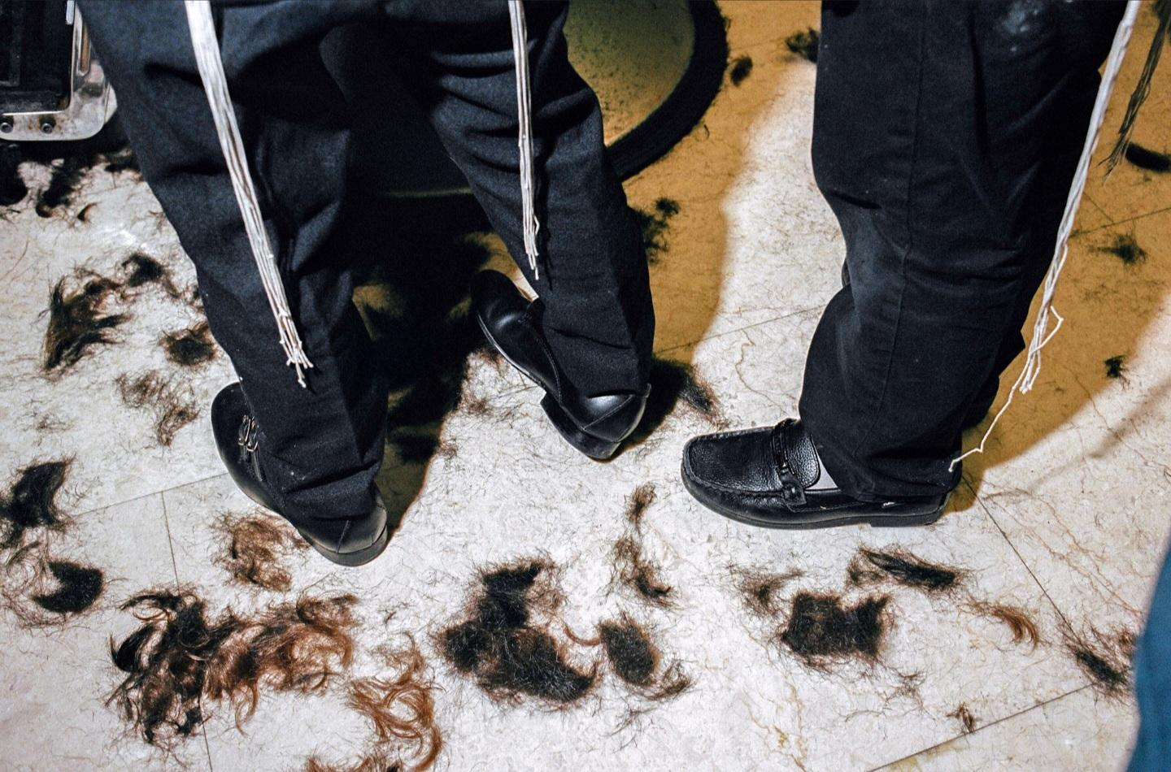
Notes:
Guy Greenberg, Barbershop, 2019.
The white strings are Tzitzit, prayer strings that most Hasidic Jews wear.

Slide 11
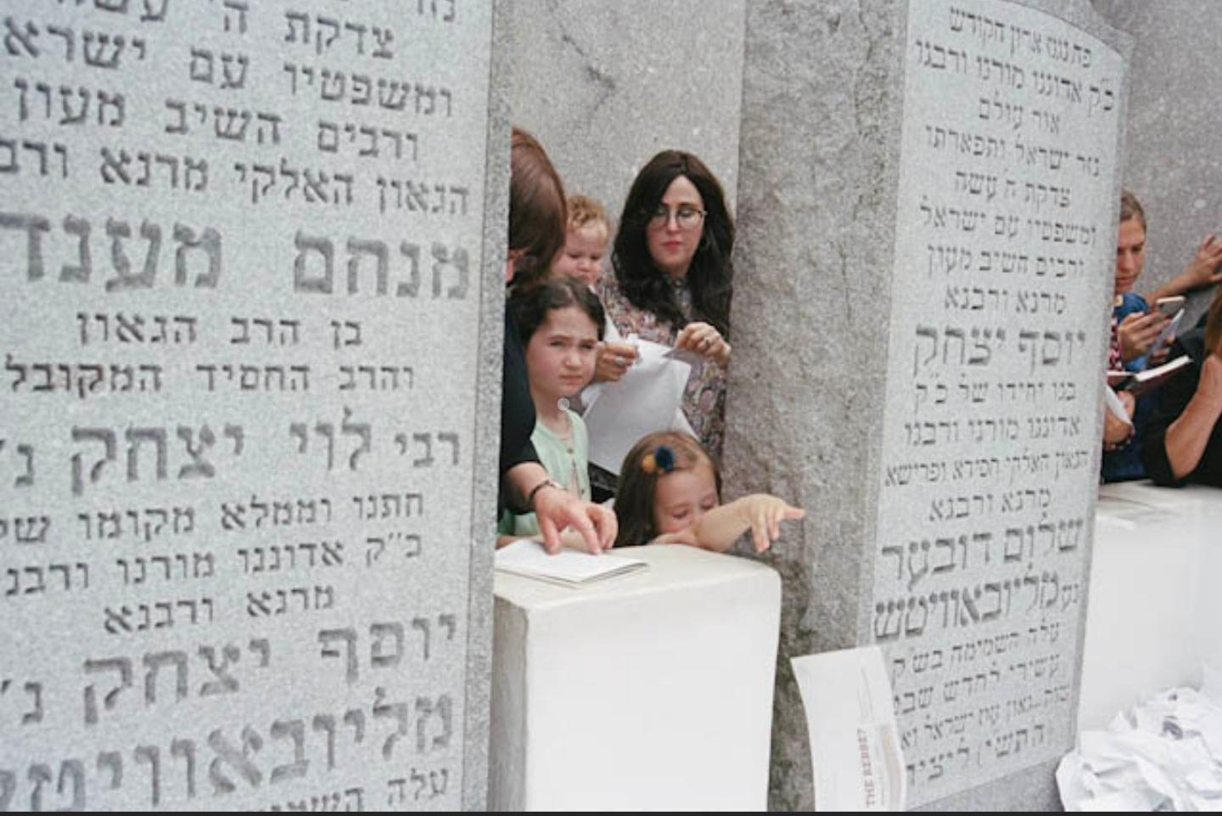
Notes:
Rebbe’s Grave, 2019

Slide 12
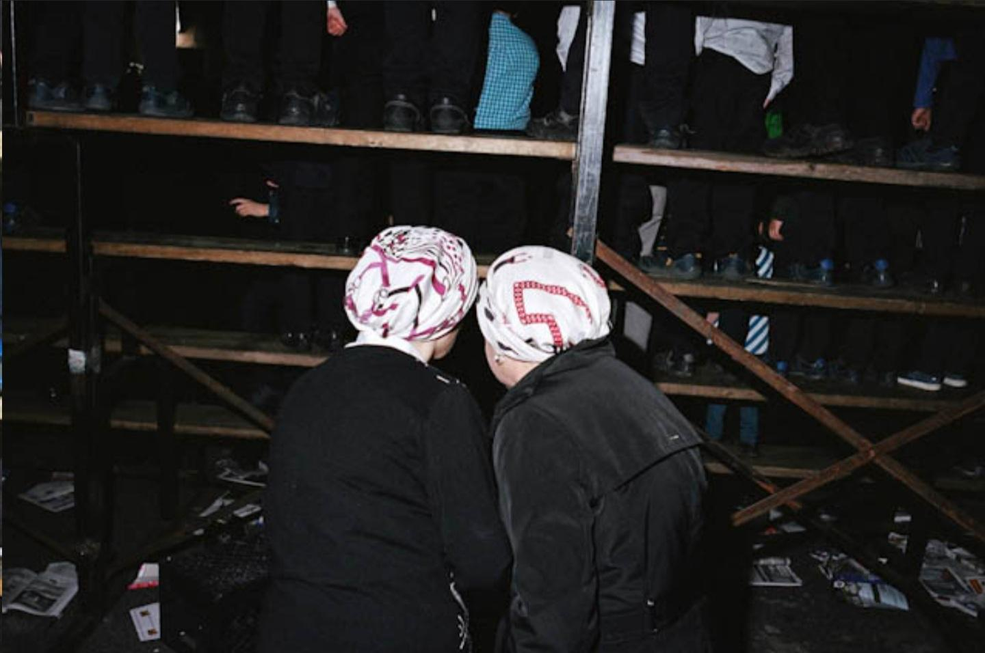
Notes:
Two Mothers, 2019

Slide 13
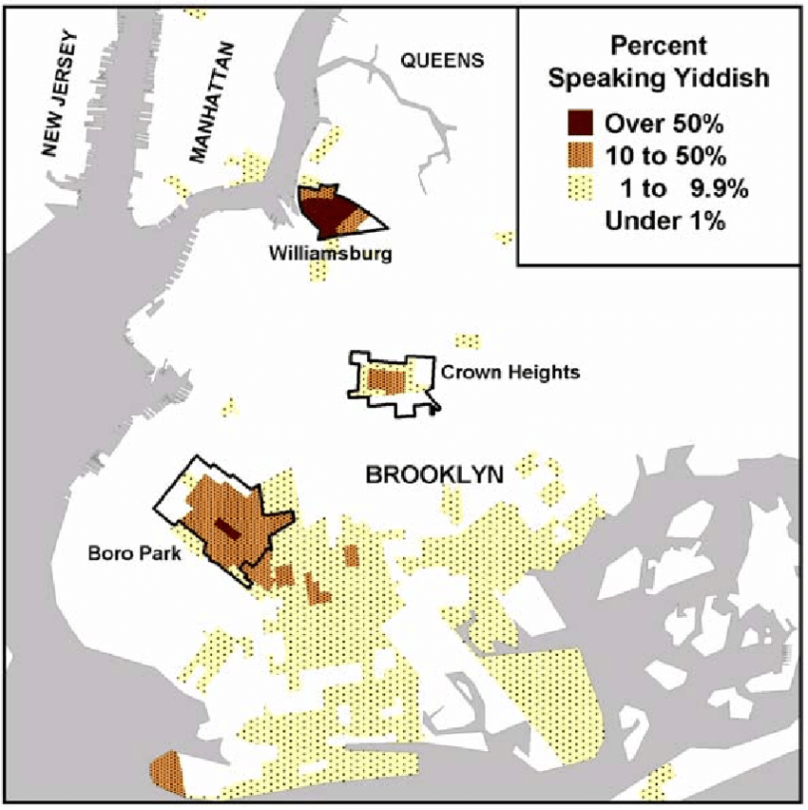
So… did you guess where they are?
→ Different sects of Hasidic Jews can be found all over the world, but one of the biggest groups can be found in NEW YORK CITY!
→ Where are the three biggest population centers?
Notes:
Be sure to point out that, like the images showed, there are differences between Hasidic Jewish groups.
Map from: https://www.researchgate.net/figure/Percent-of-adults-aged-18-and-over-in-Brooklyn-who-spoke-Yiddish-at-home-in-2000-by_fig1_248148237

Slide 14
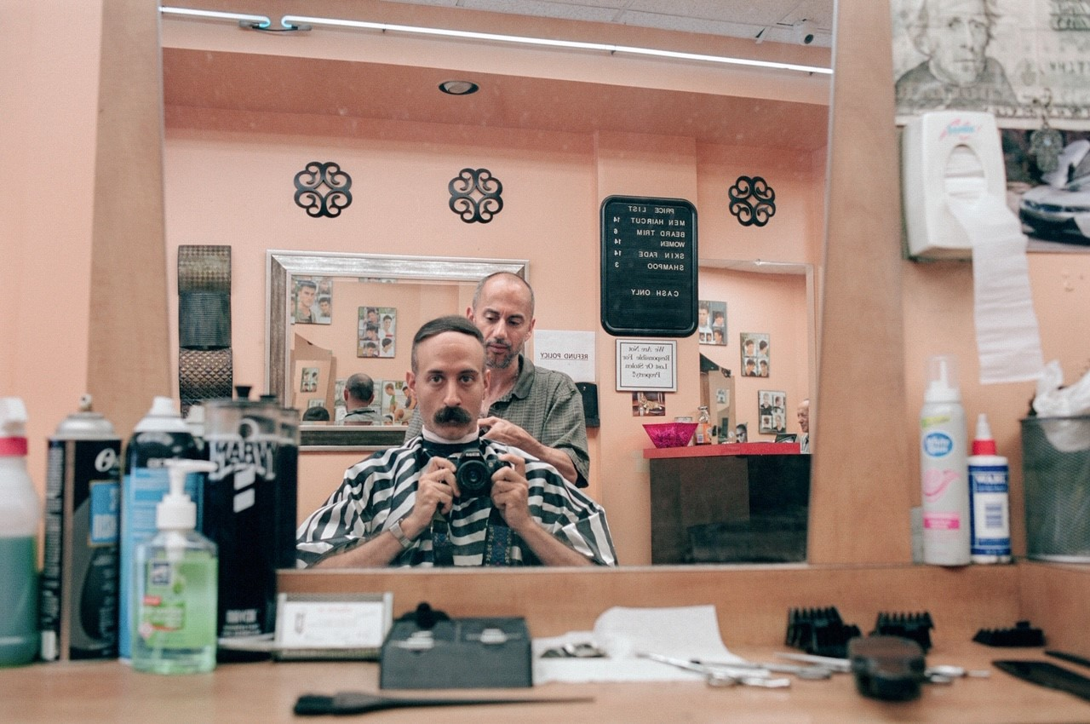
About the artist: Guy Greenberg
native of New York
started photographing the city at age 12
as a teenager, his interests turned to music and filmmaking
B.A. from the New School for Public Engagement (foci: sociology, oral history, and other forms of documentation)

Slide 15
A return to photography
returned to photography in 2014
his passion: street photography in New York and other cities

Slide 16
Word Wall Directions
Step 1: Get into groups of 3. Send one group member up to get vocabulary words index cards.
Time: 1 minute
Step 2: Use dictionaries or phones to create definitions for the vocabulary words on the index cards.
Time: 10 minutes
Step 3: Each group will post definitions on the Word Wall and present to the class.
Time: 3 minutes for each group
Notes:
Words
Judaism, Hebrew, Synagog, Mitzva, Torah, Talamund, yeshiva, kosher, monotheistic

Slide 17
Reason It Out
Discussion
We just learned a lot of new words…. Using your context clues, discuss with your group how these vocabulary words connect to the images you viewed.
Time: 5 minutes!
Notes:
As students finish, as for volunteers to share what they think they will learn about.
Handout worksheet after students have shared.

Slide 18
A Hasidic Jewish Community in NYC
Watch the following video to see what Crown Heights, a Chabad-Lubavitch Community in New York, is like.
Make note of all the vocabulary words you hear or know, as well as new or unknown words.
VIDEO: https://www.youtube.com/watch?v=6K9HDmfKcso
Notes:
Video is 2:42 min.
Have students watch the brief video about Crown Heights hosted by Rabbi Yoni Katz. Rabbi Katz hosts walking tours in the Chabad-Lubavitch community, an orthodox Jewish Hasidic movement with origins in Russia. While they view, have students make a note of any vocabulary words they hear or see in the video, as well as any new or unknown words. As students make note of new words, allow them time to look up their definition after viewing the video, and add to Word Wall.
Image source: https://dribbble.com/shots/3315442-Crown-Heights-Badge

Slide 19
Final Questions
How does art help us understand people in different cultures?
Have the Hasidic Jews in the video assimilated into the culture around them?
What do you think about assimilation? Is it brave not to assimilate to the culture around you --- or is it brave to assimilate?
Can tensions rise when people don’t assimilate?
Notes:
.

Slide 20
Project
Create a photobook of your culture. Take 5-10 pictures of things that represent your life and culture.
Are there aspects of your culture that have not been “assimilated”?
Notes:
Image sources:
https://www.graphicsfactory.com/Clip-Art/People/Artists/Art14-156
https://clipartart.com/categories/cel-phone-camera-clipart.html

