Slide 1
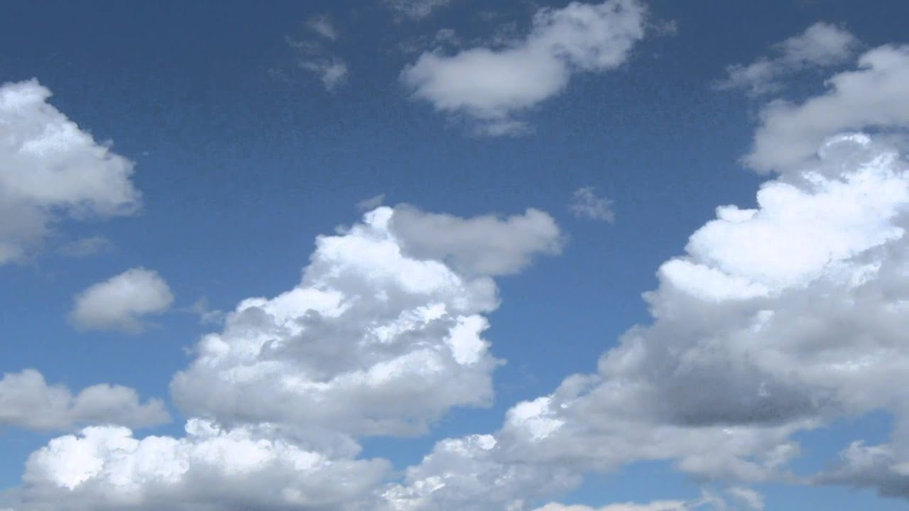
Notes:
Start the class by showing the following “Clouds Background” video: https://www.youtube.com/watch?v=o6wMCkY7kjA (0:57). As the video plays in the background, ask students to engage in a stand and share based on the following questions: “What comes to mind when you think about clouds?”

Slide 2
Clouds, Clouds Everywhere

Slide 3
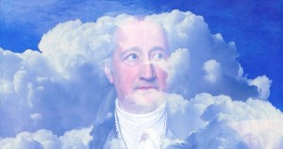
How did clouds get their names?
Notes:
Have students watch the following video, “How did clouds get their names?,” that outlines the history of and various types of clouds. Video can be found at: https://www.youtube.com/watch?v=UuW1jhxCgx0 (5:06).

Slide 4
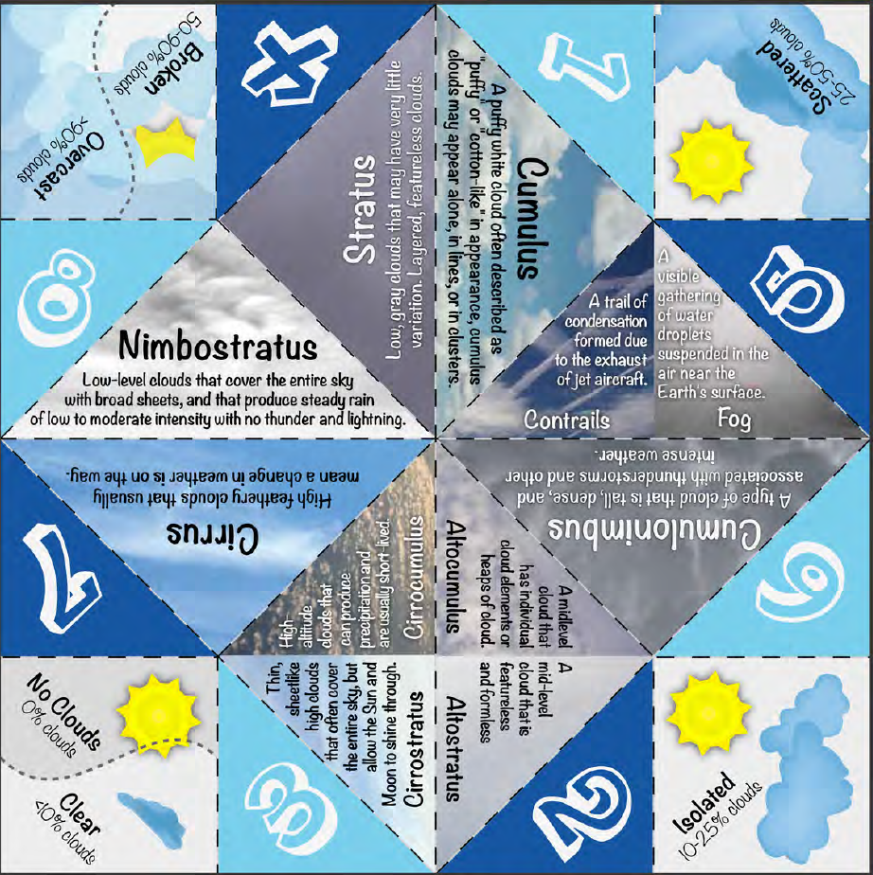
Make your own Cloud Teller!

Slide 5
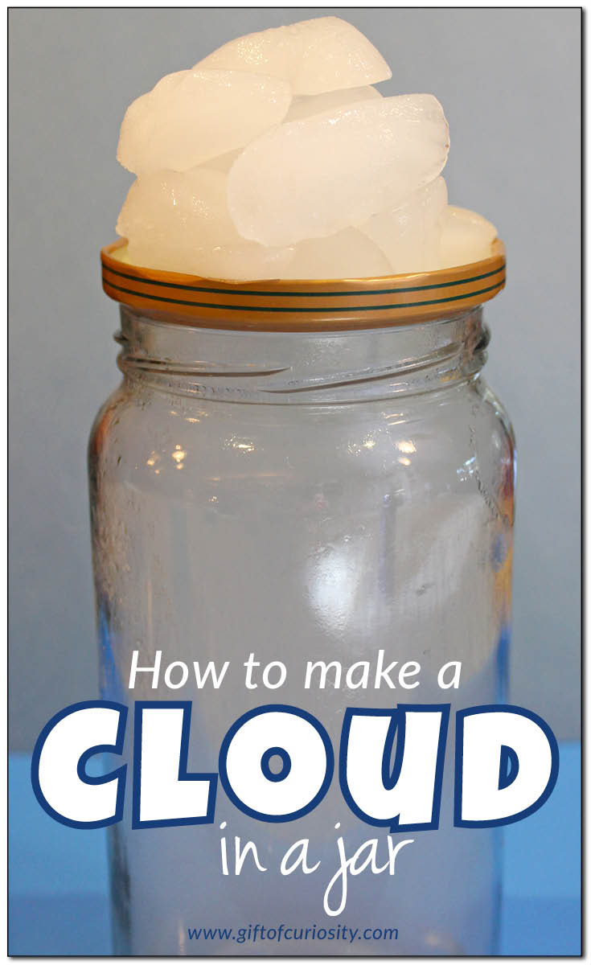
Notes:
Have students watch the following video that explains how clouds are made (3:10): https://www.khanacademy.org/partner-content/nova/clouds/v/makingofacloud. Follow this video with another video by NASA (3:15): https://www.nasa.gov/audience/foreducators/topnav/materials/listbytype/Learning_About_Clouds.html. Then, organize students in groups of four, and tell them they will make their own clouds (two different methods). Directions for this activity can be found at: https://www.giftofcuriosity.com/weather-science-how-to-make-a-cloud-in-a-jar/.

Slide 6
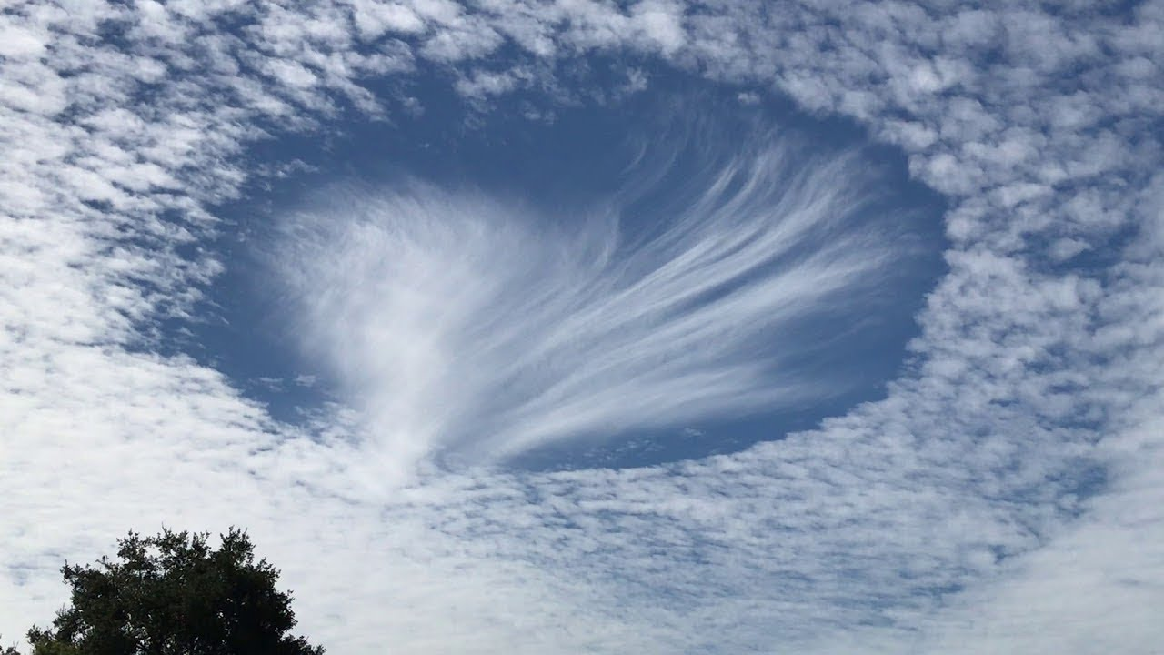
The History of Weather Modification
Notes:
Have students watch the following video that explains the history of weather modification (3:45): https://www.youtube.com/watch?v=f8HwK2tDL4Y. Then have students watch the following video that explains solar radiation management (2:42): https://www.youtube.com/watch?v=w8zM8nmm2_s.

Slide 7
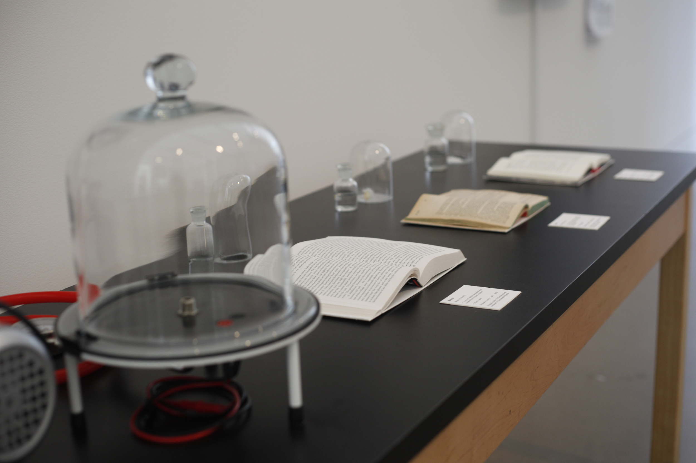
A memory, an ideal, a proposition
Karolina Sobecka (2017)
Notes:
Now we will learn about an art exhibition titled, A Memory, an Ideal, a Proposition, by a New York-based artist and designer who is working at the intersection of art, science, and technology.

Slide 8
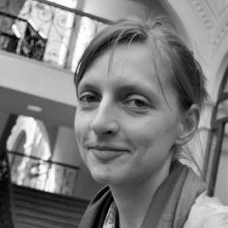
Karolina Sobecka
b. 1977, Warsaw, Poland
BFA: Art Institute of Chicago
MFA: California Institute of the Arts
New York-based artist
works at the intersection of art, science and technology
creates installations, videos, animations, mixing new and old media

Slide 9
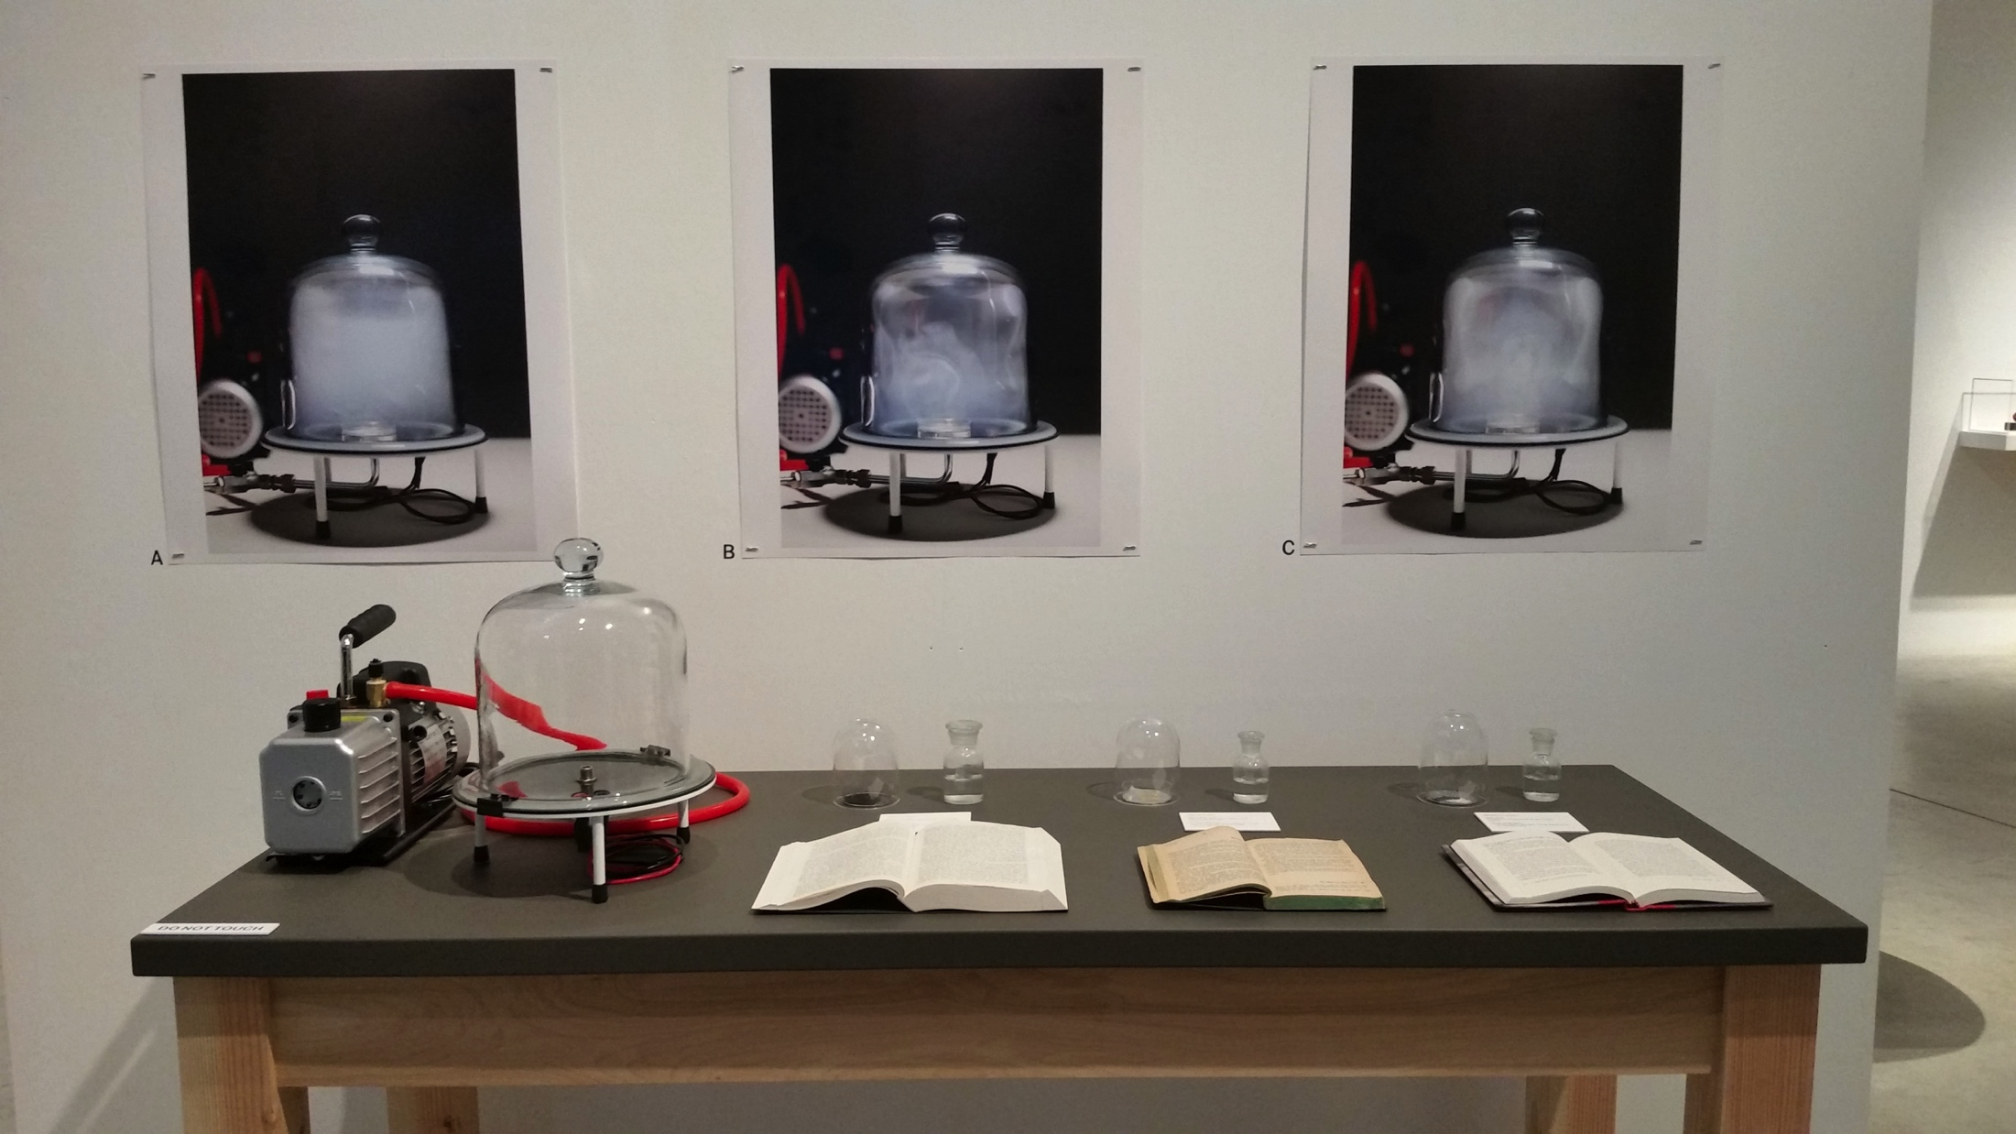
A memory, an ideal, a proposition, Karolina Sobecka, 2017. Aerosols, water, vacuum pump, books, table, prints. Dimensions variable.
Notes:
This work documents an attempt to reassemble three clouds that changed the world.

Slide 10
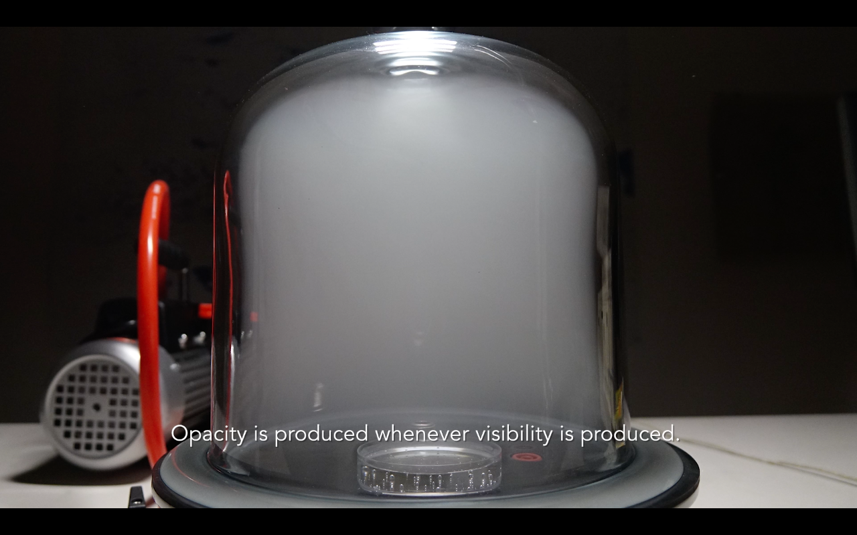
A memory, an ideal, a proposition, Karolina Sobecka, 2017. Aerosols, water, vacuum pump, books, table, prints. Dimensions variable.

Slide 11
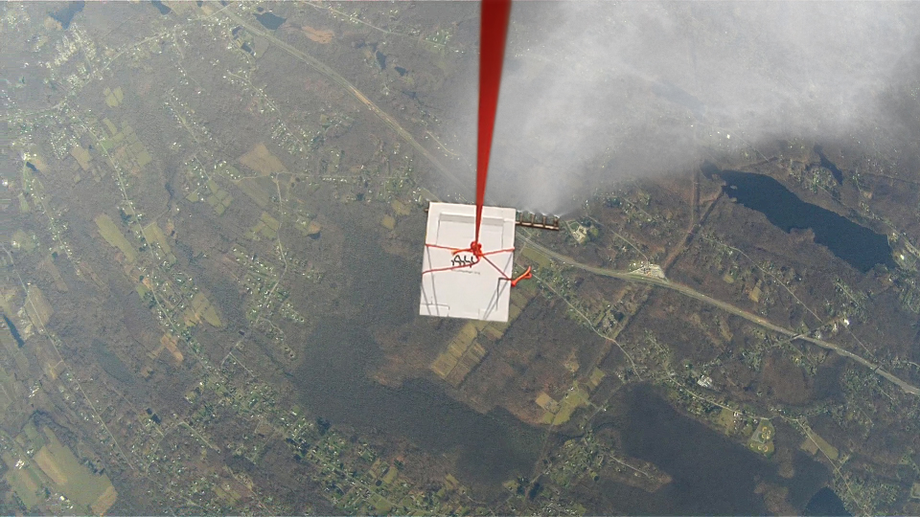
Tucson, Arizona (2019)
Notes:
Explain that one of the clouds she creates, titled “A Proposition” is scheduled to be produced in 2019 eight miles above the ground in Tucson, Arizona as part of a first ever field test in Solar Radiation Management.
Image source: hhttp://www.karolinasobecka.com/artwork/cloud-machine

Slide 12
Think-Write-Pair-Share
Should humans be engaging in weather modification?

