Slide 1
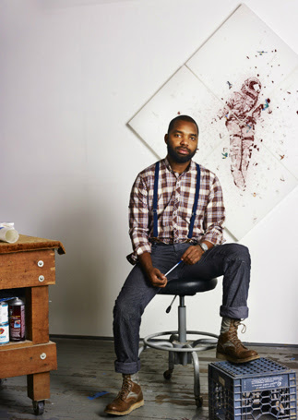
Tavares Strachan
The Visible Turn
Notes:
Image: Tavares Strachan in his studio. Photo by Andy Romer, courtesy of the artist.
Source: http://www.thebahamasweekly.com/publish/arts-and-culture/Bahamian_named_one_of_six_hottest_living_artists33792.shtml

Slide 2
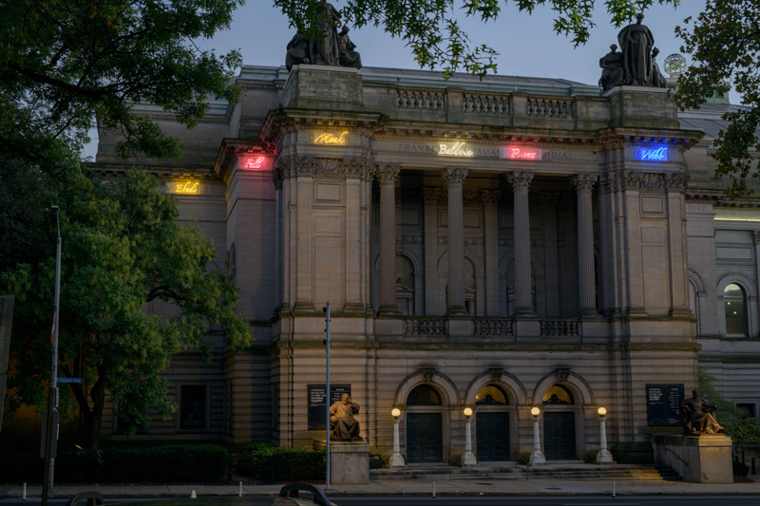
Notes:
Ask students to describe the building --- its features, its setting, possible location and function, and any striking details they note.
Tavares Strachan, The Encyclopedia of Invisibility, installation view, 2018. 57th Carnegie International. Photo: Bryan Conley.
Image source: https://brooklynrail.org/2018/11/artseen/Carnegie-International-57th-Edition
Tavares Strachan uses neon signs to add the names of overlooked figures, including African American and feminist heroes, to those inscribed on the stone of the original building—Beethoven, Michelangelo, Newton, and Shakespeare (all famous white men).
Some of the people chosen by Strachan to be included in the project: Robert Hayden, Ahmad Baba al Massufi, Agnes Luise Wilhelmine Pockels, Rosalyn Yalow, Shirley Chisholm, George Edwin Taylor, Oscar Zeta Acosta, Bruno Manser, Francesca Woodman, Francis “Frank” Johnson, Mel Blanc, Alison Hargreaves
Inspired by the names of important historical figures that are inscribed in the façade of the museum, Tavares Strachan added his own set of names of significant people to the exterior of the building, in neon. In the artist’s attempt to correct what he calls the “social amnesia of forgetting,” he makes visible the people heretofore forgotten by history. Now, along with Shakespeare and Michelangelo, there are also the names of Robert Lawrence, the first African-American astronaut, and English chemist Rosalind Franklin, who contributed to our understanding of DNA.

Slide 3
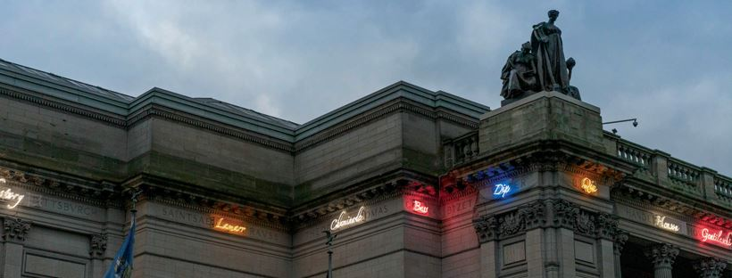
Notes:
Allow volunteers to come closer to the screen to read any words they are able to make out. Ask: What might these words in neon mean? Why are they in neon?
Background informational note to teacher:
Tavares Strachan: “Last night we opened the Carnegie International, where I was asked by Ingrid Schaffner, to contribute about two years ago. At that time, I was researching people who had done incredible things yet not fully recognized for their contributions, rendering them and their actions Invisible. The Carnegie Museum, built in 1905 etched onto its facade names of great men who contributed to science, technology, and the arts, but on this list included no women or people of color. This intervention of adding names of truly amazing invisible people that did not make the original list in 1905 was my small way of saying that perhaps history is not fixed.” (Source: https://www.toopics.com/p/1889414588393261541_294728568.)

Slide 4
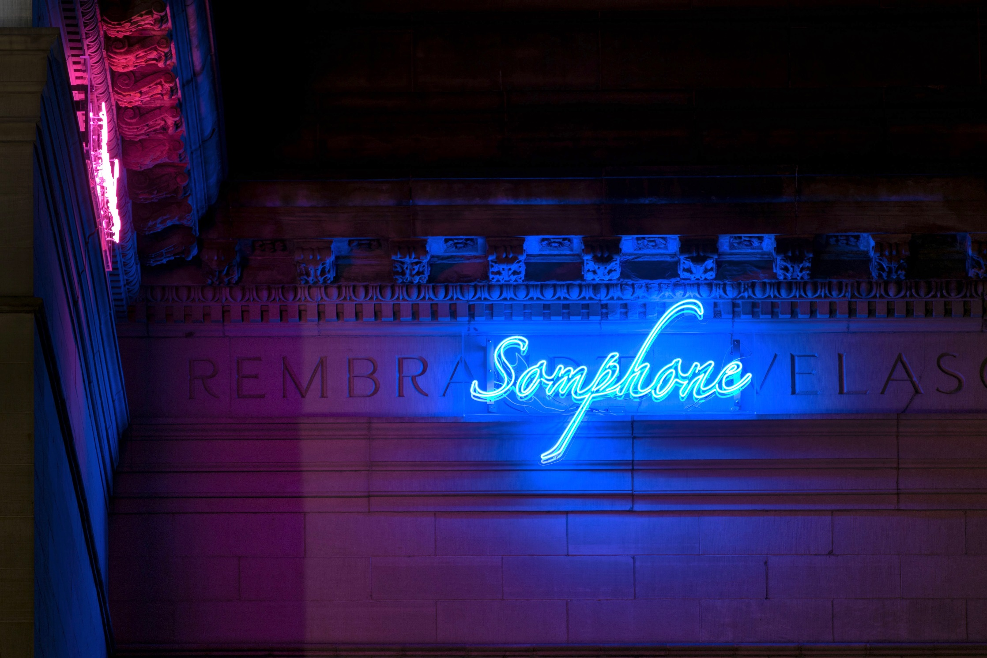
Notes:
What words is ‘Somphone’ in neon partially covering? (Rembrandt, the most famous of Dutch painters; Velázquez, an important painter of Spain’s Golden Age)
What do you think ‘Somphone’ refers to? [Click on the slide to animate Somphone’s photo to be revealed.] Explain that Sombath Somphone was a community activist in Laos, recognized for his work in rural and agricultural development. He was detained by Laotian police in 2012 and hasn’t been seen since.
Art image source: https://entertainmentcentralpittsburgh.com/artistry/carnegie-international-review/
Sombath image source: http://www.padetc.org/about-us/our-founder/
Somphone: Sombath Somphone, honored for his work in rural and agricultural development in Laos, was for unknown reasons detained by Laotian police in 2012 and hasn’t been seen since.

Slide 5
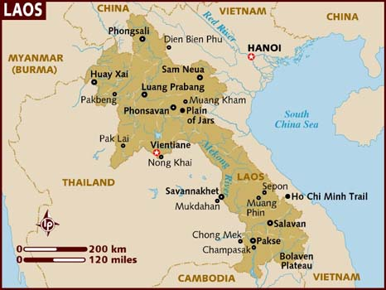
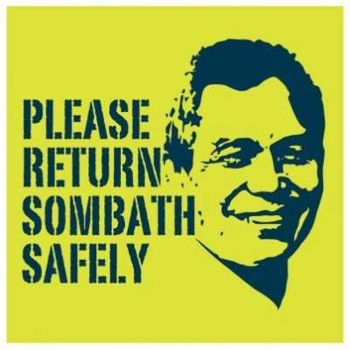
Notes:
Map source: https://www.lonelyplanet.com/maps/asia/laos/
Poster source: https://focusweb.org/content/where-sombath-somphone-0

Slide 6
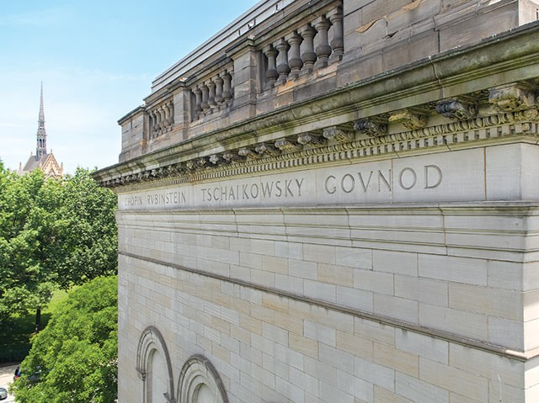
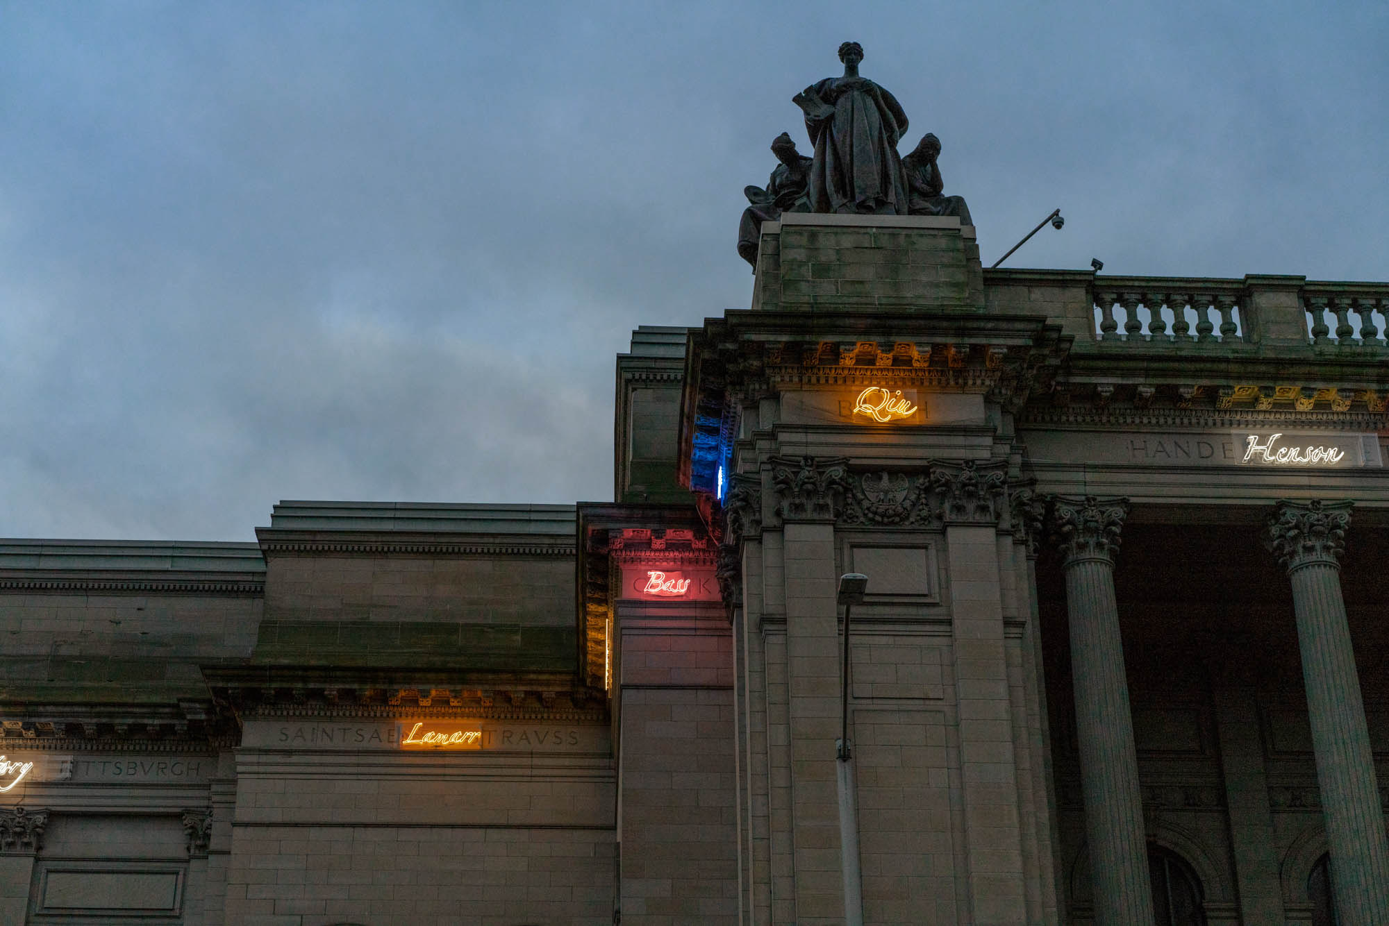
Notes:
Ask: What is the artist trying to say with this work? (Explain that of all the names etched on the façade of the Carnegie Museum of Art, not one is a woman or a person of color..) In this work, Strachan sought to bring visibility to people who have been forgotten by history, in his estimation.
Image sources:
https://www.pghcitypaper.com/pittsburgh/get-lost-in-the-carnegie-international-57th-edition/Content?oid=11204744
http://viaartfund.org/grants/tavares-strachan-encyclopaedia-invisibility/

Slide 7
Jack Johnson
Strachan: “I remember I first heard of the boxer, Jack Johnson, when I was a 24 year old graduate student. He was an American boxer who, at the height of the Jim Crow era, became the first black world heavyweight boxing champion (1908–1915)…Among his other achievements, he patented a wrench in his workshop. The Carnegie Museum of Art now includes the name of Jack Johnson on its building façade, along with 60 other names of once invisible people…”
Notes:
Strachan: “I remember I first heard of the boxer, Jack Johnson, when I was a 24 year old graduate student. He was an American boxer who, at the height of the Jim Crow era, became the first black world heavyweight boxing champion (1908–1915). He once said to a reporter when asked why black men were so loved, it was because “we eat cold eel and think distant thoughts.” Among his other achievements, he patented a wrench in his workshop. The Carnegie Museum of Art now includes the name of Jack Johnson on its building facade, along with 60 other names of once invisible people that are now added as a part of my contribution to the International!” (Source: https://www.toopics.com/p/1890774954188694192_294728568.)
Note to teacher: Married to a white woman, Johnson was arrested Johnson for violating the Mann act (the transport of a woman across state lines for "immoral purposes“). Johnson was posthumously pardoned in 2018 and a biopic about the boxer by Sylvester Stallone is in the works.
Image source: https://geektyrant.com/news/sylvester-stallone-is-set-to-make-a-film-about-boxer-jack-johnson-who-was-recently-pardoned-by-president-trump

Slide 8
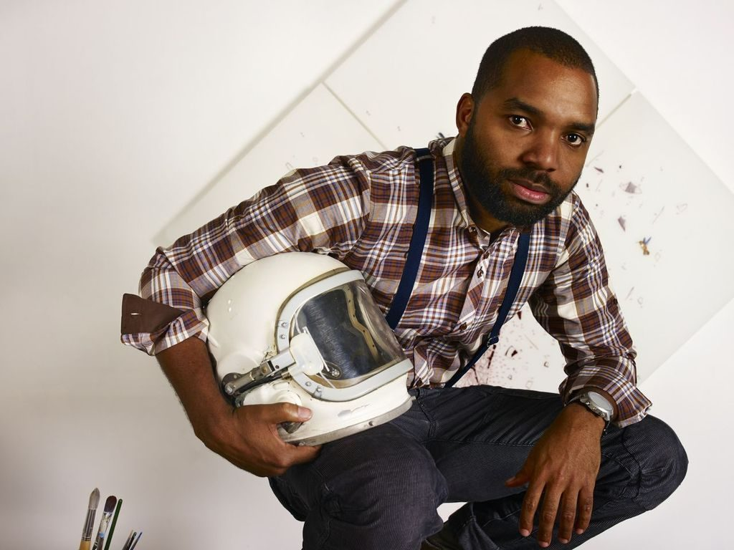
Tavares Strachan:
A Brief Biography
Notes:
Image: Tavares Strachan in his studio. Photo by Andy Romer, courtesy of the artist.
Source: https://news.artnet.com/art-world/tavares-strachan-allen-institute-spacex-lacma-1218743

Slide 9
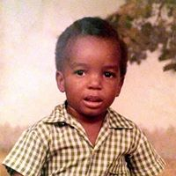
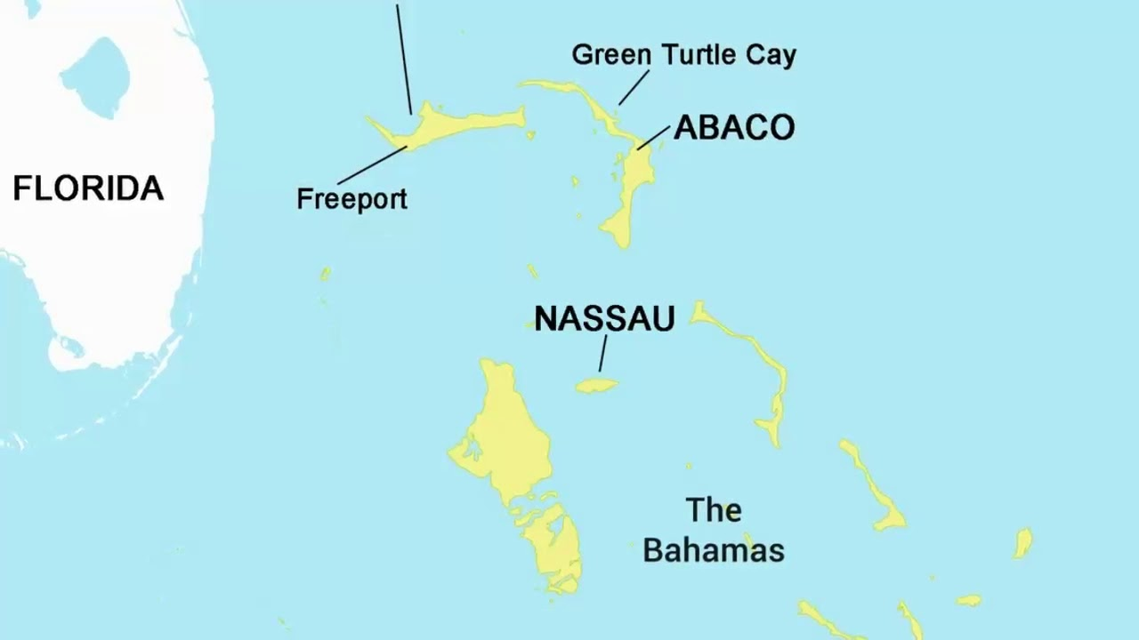
Tavares Strachan (b. 1979): Background
Born in Nassau, Bahamas
Childhood:
did not have access to the masterpieces of Western art;
gained much of his knowledge pf the outside world through highly edited, printed encyclopedias (e.g., the World Book Encyclopedia and the Encyclopedia Britannica)
BFA , Rhode Island School of Design (2003)
MFA, Yale University (2006)
Notes:
Childhood photo of Tavares: FaceBook, https://www.facebook.com/TavaresStrachan
Removed by distance from any direct access to the masterpieces of the Western art, as a child Strachan admittedly gained much of his knowledge of the outside world, including art, through several highly edited, currently anachronistic printed encyclopedias—such as the World Book Encyclopedia and the Encyclopedia Britannica.
Tavares remembers having o wear white gloves when he read his grandmother’s encyclopedias. As a child, he wondered who gave the writers of these books the authority to be the final say on the contents, and thus decided to make his own.
For his installation The Encyclopedia of Invisibility, Strachan has appropriated, updated, amended, and added his own entries into a collection of alphabetized listings which themselves make up an alternative history of the unrepresented, the underexplored and the unseen.

Slide 10
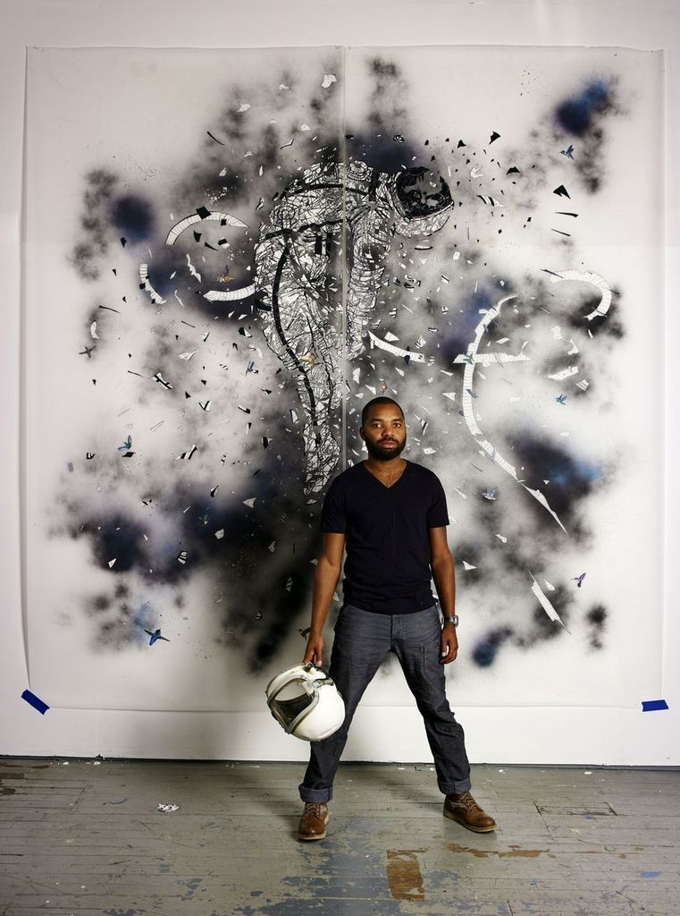
Tavares Strachan: Today
Lives and works in New York and Nassau
Conceptual artist
Specializes in multi-media installations
Areas of interest: science, technology, mythology, history, and exploration
Much of his work focuses on giving visibility to the invisible

Slide 11
The Encyclopedia of Invisibility
Notes:
The final document is 2,436 pages with over 20,000 entries

Slide 12
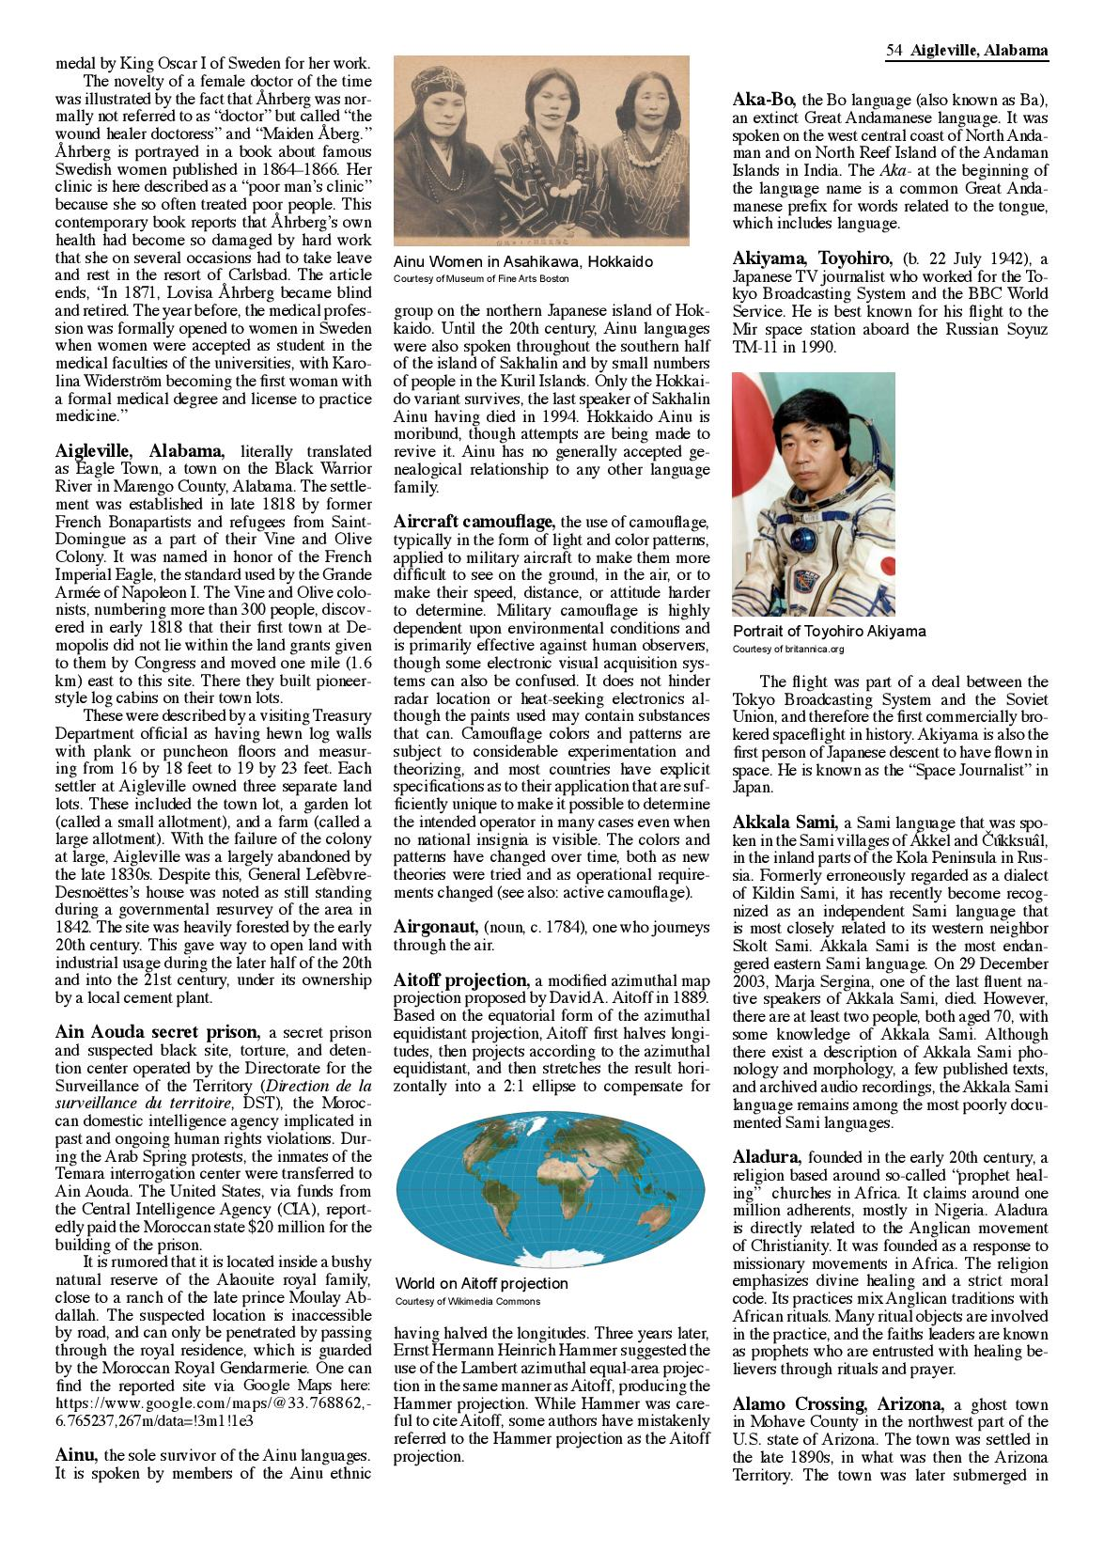
The Encyclopedia of Invisibility
2,000-page encyclopedia featuring information on invisible persons, places, groups, and things the artist has collected
“What are we missing? What are we not seeing?”
- Tavares Strachan, 2015
(Excerpts of 'A' from) The Encyclopedia of Invisibility,; Tavares Strachan (2017)
Notes:
It includes, among other figures, Rosalind Franklin, the historically overlooked scientist who laid the groundwork for Francis Crick and James Watson’s discovery of DNA’s double-helix structure, and Matthew Henson, the African-American explorer only sometimes acknowledged as the co-discoverer of the North Pole with Robert Edwin Peary in 1909.
For The Encyclopedia of Invisibility, Strachan has appropriated, updated, amended, and added his own entries into a collection of alphabetized listings which themselves make up an alternative history of the unrepresented, the underexplored, and the unseen.

Slide 13
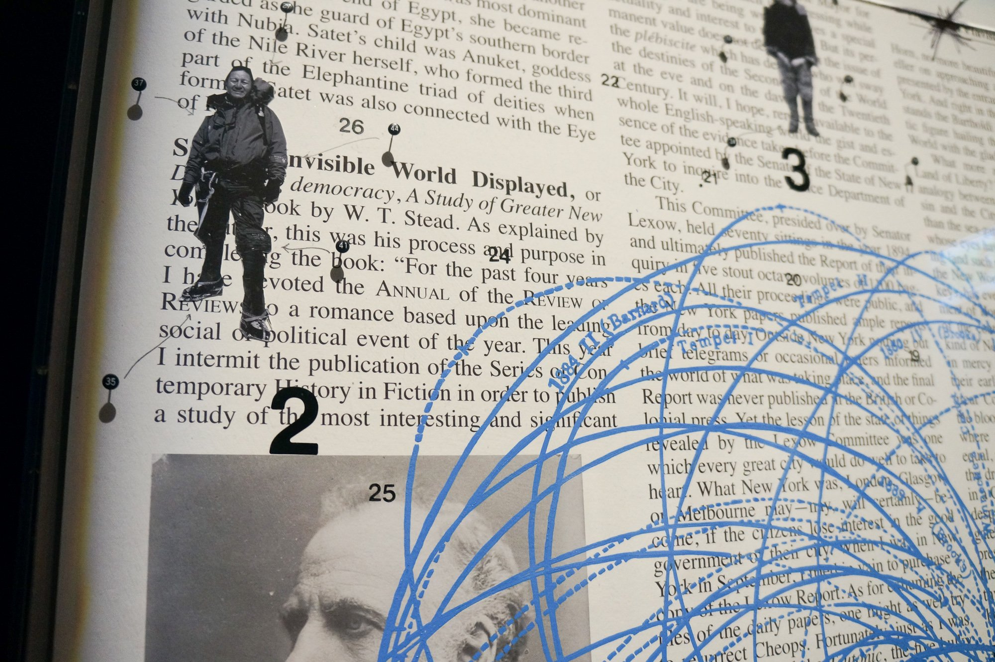
Notes:
Detail from The Encyclopedia of Invisibility
Image source: https://secretlocation.ca/blogs/secrets/tavares-strachan-always-sometimes-never

Slide 14
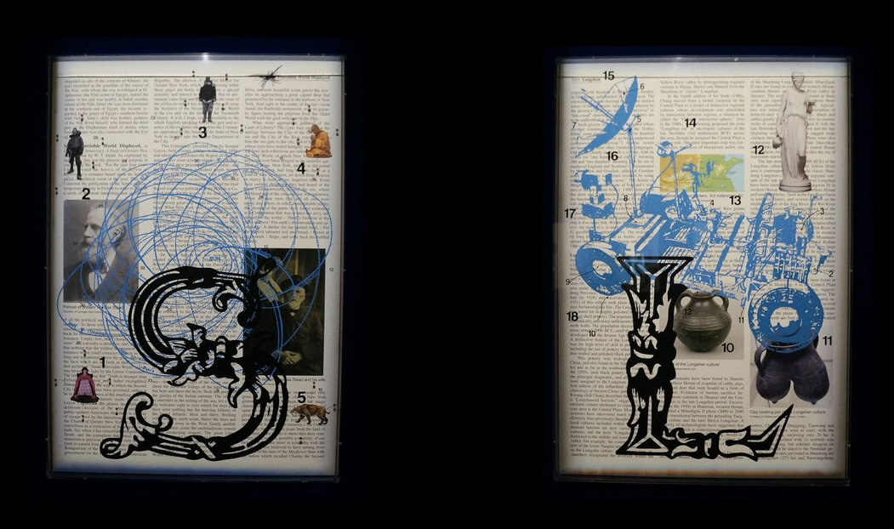
Strachan: “For me, an encyclopedia is a fundamental paradox: the premise of it is it’s a place where most knowledge will be kept. So, we just went through the process of looking and seeing what has been left out of encyclopedias to examine how cultures are really constructed…”
Notes:
Image source: https://secretlocation.ca/blogs/secrets/tavares-strachan-always-sometimes-never

Slide 15
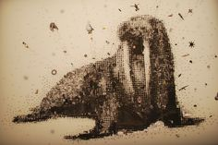
Constellation Experiment series
Notes:
The Constellation Experiment series is a project about the Polar Eclipse. The exhibition includes various collections of installations, videos, sculptures and collage works by the artist. Walking through the exhibition, Strachan shares with us his experiences from an expedition to the North Pole. He created pieces that narrate his journey and explore themes of culture, physical displacement, and the evolution of historic discoveries. The artist successfully executed his theme of displacement, both emotionally and physically, through geographical and scientific measurements. His work beautifully combines art and science.

Slide 16
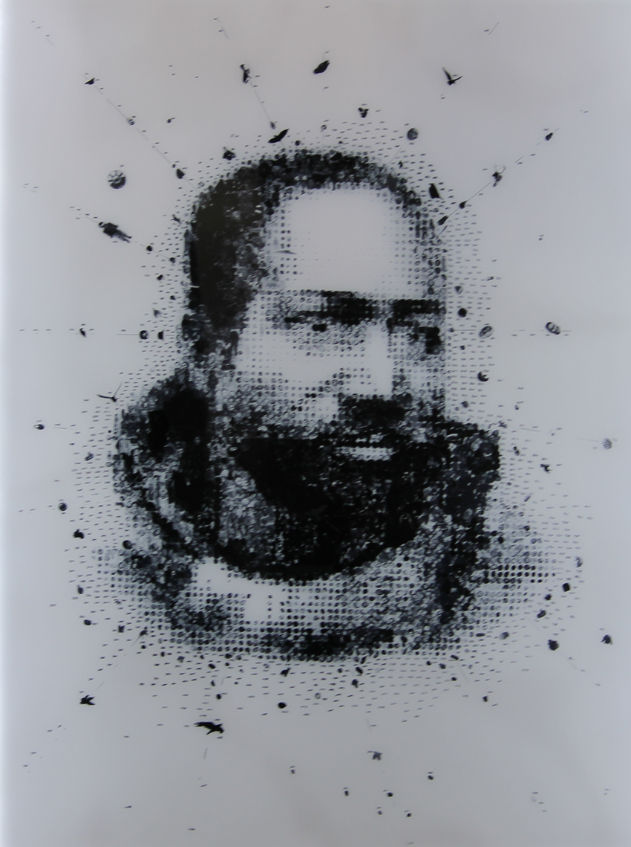
Mathew Henson (2012)
Constellation Experiment series
Light box 152.4 x101.6 x 5.1 cm
Notes:
Image source: http://pomeranz-collection.com/?q=node/214
The notion of invisibility continues in this collection with this collage/portrait.
Mathew Henson (2012) is a fragmented portrait of the explorer, Mathew Henson. Henson was the first to discover the North Pole in 1909 with Robert Peary, but was not credited for his contributions because of his race.
In this piece there are no actual images of Mathew Henson used --- only images from aspects of his life, for example, his family, dog sleds, arctic tools for hunting, his house, and a number of his personal experiences during his time in the arctic. The artist printed images then out cut them and built a portrait of this unknown explorer.

Slide 17
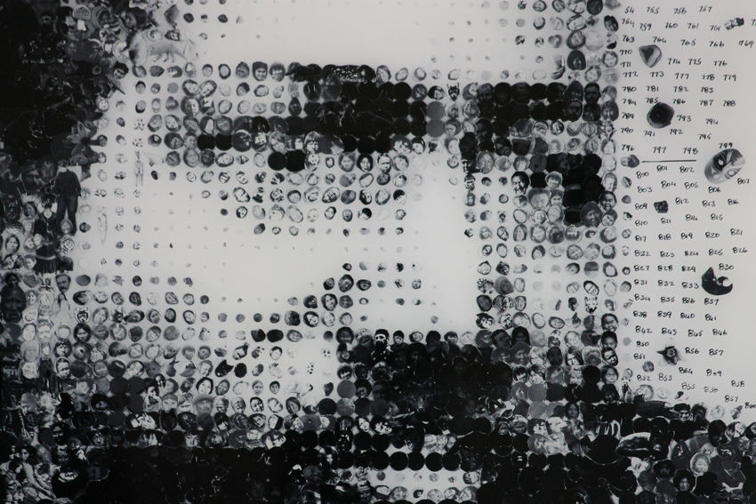
Notes:
Detail from: Mathew Henson (2012)
Image source: http://pomeranz-collection.com/?q=node/214
“This work, which is part the Constellation Experiment series, is dealing with the idea of invisible. The numbers are used to catalog each object in the collage. The same way an analyst would analyze a crime scene, the numbers are attempting to find order. The numbers also now represent a kind of aesthetic chaos and an explosion of scientific data.”

Slide 18
The Invisibles series
2014-2015
Notes:
“The Invisibles” comprises objects that were meaningful to Rosalind Franklin, a historically overlooked scientist who laid the groundwork for Francis Crick and James Watson’s discovery of DNA’s double-helix structure.

Slide 19
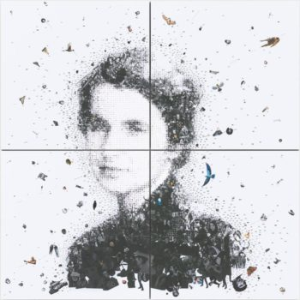
Rosalind (2014-2015)
Notes:
Image source: http://www.artnews.com/2015/11/12/its-never-really-over-tavares-strachan-on-his-new-rosalind-franklin-inspired-show/
Rosalind Franklin is the historically overlooked scientist who laid the groundwork for Francis Crick and James Watson’s discovery of DNA’s double-helix structure.
Franklin died at the young age of 37 of cancer. She was excluded from the Nobel Prize (it’s not given posthumously) that Watson, Crick, and Maurice Wilkins were awarded in 1962.

Slide 20
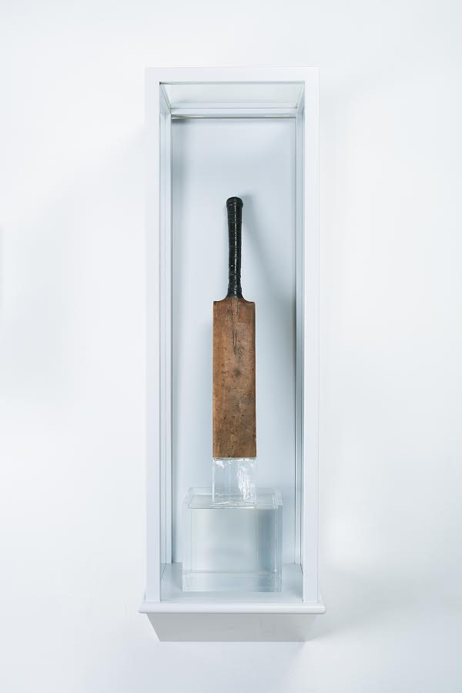
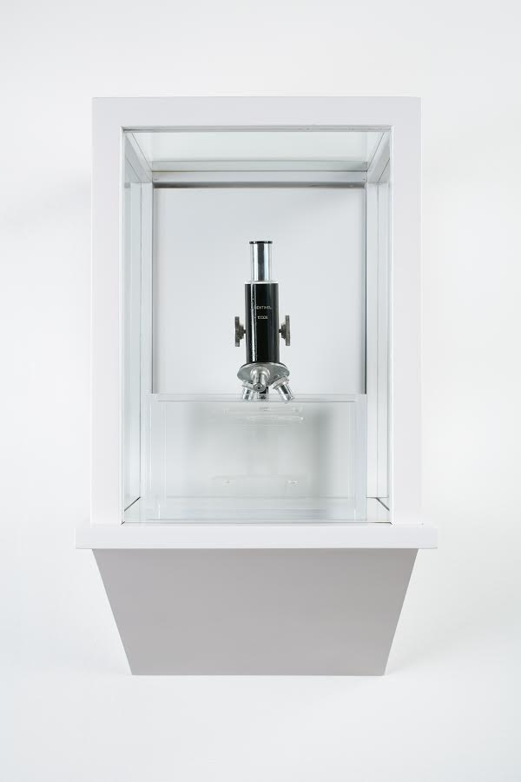
The Invisibles (Rosalind Franklin) (2014-2015)
Notes:
The objects in the series are partly transparent: e.g., a pair of nurse’s shoes (she included her nurse in her will), a cricket ball and bat (she was an avid fan of the sport), and a microscope.
Image Source: https://www.guernicamag.com/tavares-strachan-the-breaking-is-the-fixing

Slide 21
“Tavares Strachan edits history by placing Tupac Shakur’s name on the Carnegie Museum of Art”
To what three fields was the Carnegie Museum of Art dedicated?
Who are some of the well-known people whose names are etched on the outside of the building?
What are some examples of people’s names Strachan included in neon lights?
In addition to the names Strachan installed in neon and placed on the building, what phrase did he also include?
How did the artist involve children in the exhibition opening?
Imagine you are one of Strachan’s assistants: create a list of 3-5 individuals you believe should be included in the art project.
Notes:
literature, science, and art
Franklin, Rembrandt, Chopin, and Darwin
“Monk,” “Baldwin,” “Lamarr,” “Norgay,” and “Tupac Shakur”
“All of the people that have been made invisible through the mechanism of history.”
The children were dressed in white uniforms consisting of a bomber jacket adorned with patches (each one had a name of one of the invisible), collared shirt, tie, and slacks. The kids acted as museum docents, giving participants a tour of the project. Each child stood on a soapbox and recited information about the character he or she embodied.
Note to teacher: In describing the process of developing encyclopedia entries, Tavares has said: “I think about the next generation. About what is required to be skeptical of the work and skeptical of authority.” (Strachan, T. Artist Talk, USF Contemporary Art Museum, January 11, 2019, Tampa, FL.)
6. Varies by student.

Slide 22
“We’ve got to find our own way of putting the pieces together, deciding what’s important and what will, inevitably, be left out.”
THINK & WRITE:
If you were to make a list of 10 things, events, places, and/or people that define who you are and what you hold dear, what would they be?

